Slide 1
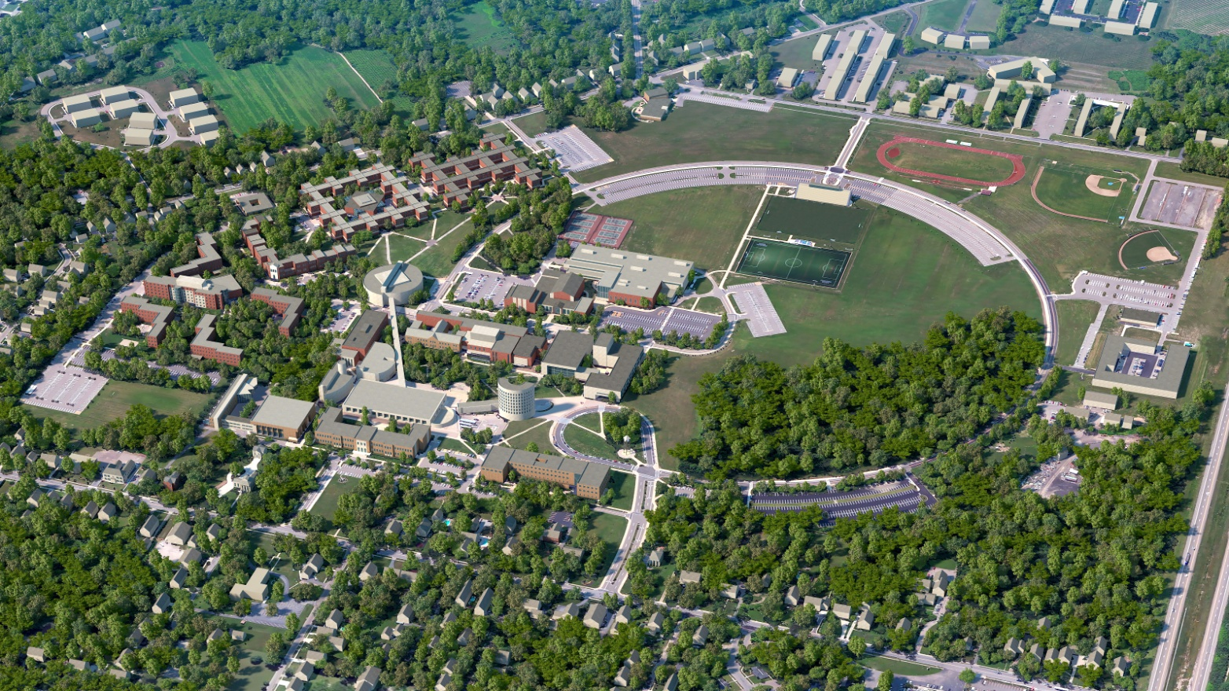
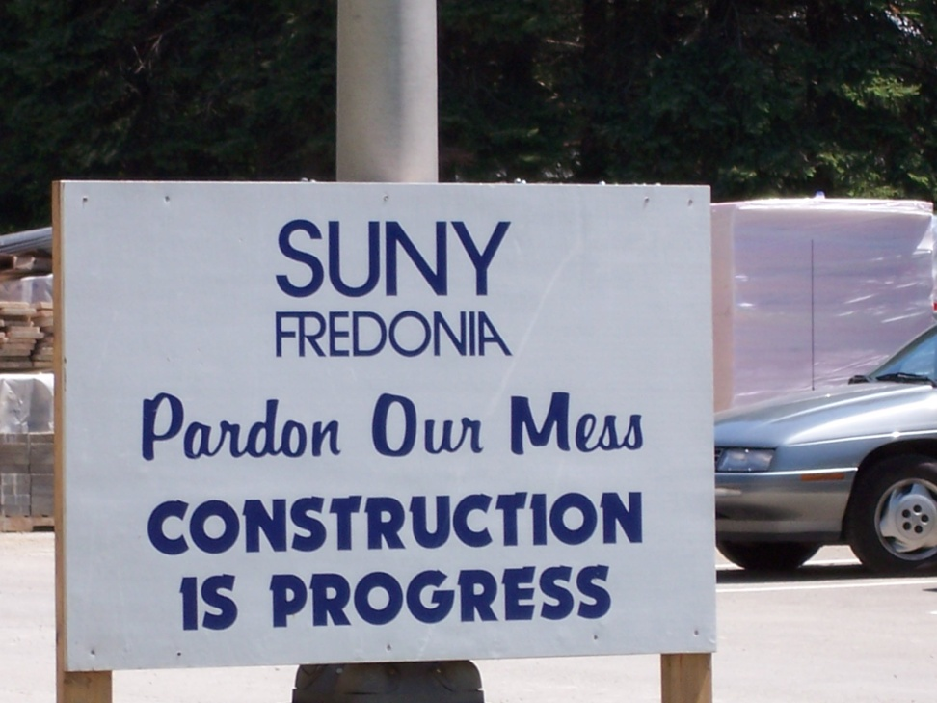
SUNY Fredonia
Summer 2014 Projects

Slide 2
Agenda
Academic / Administration Projects
Residence Hall Projects
Site Work
Minor Critical Maintenance Projects
Notable Construction Impact to Campus
Project Recap
Question and Answers

Slide 3
  Academic / Administration Projects
Science Center [$60M]
Rockefeller Arts Center Addition and Renovation [$36M]
Rehab/Upgrade Elevators Various Buildings [$1.5M]
Houghton Hall Rehab [$33 M] (In Design)
Steele Hall
Mason Hall
McEwen Hall
RAC Addition & Renovation
Science Center
Maytum Hall
Houghton Hall
Fenton Hall
Thompson Hall

Slide 4
  Residence Hall Projects
Townhouse [$30M]
Disney Hall Lobby Upgrade [$550K]
Andrews Complex Window Replacement – IV Phases [$6.1M ]: Phase I – Igoe Hall [$1.5 M]
Interior Lighting and Occupancy Sensors – Grissom Hall / Kasling Hall [$150K]
Cleaning Limestone Window Sills – Chautauqua Hall / Nixon Hall [$9.8K]
ADA Signage – Hendrix Hall [$25K]
Interior Painting – Various Locations [$85K]
Hendrix Hall
Disney Hall
Student Rooms, Corridors
and Doors/Frames
Igoe Hall
Kasling Hall
Grissom Hall
Townhouse ▪
Chautauqua Hall
Nixon Hall

Slide 5
Site Work
Milling and Paving at Old Main Drive [Extending from Alumni Hall to LoGrasso Hall
Ring Road (Adjacent to Parking Lots 9A/9D) [$175K]
Parking Lot and Roadway (Crosswalks) Striping [$25K]
Ring Road
Old Main Drive
Parking Lot and Roadway Striping at Various Locations

Slide 6
Minor Critical Maintenance Projects
Maytum Hall Mechanical Room Concrete Repair [$98K]
LoGrasso Hall Boiler [$30K]
Mason Recital Hall Reheat Boiler/Humidifier [$59K]
Jewett Hall 101 Lighting [$35K]
University Commons Ventilation Improvements [$18K]
Natatorium Floor Repair [$33K]
Carnahan Jackson Center VAV Controller Replacement [$35K]
RAC Generator Exhaust Fan [$20K]
Thompson Hall Cooling Fan/Air Handling Unit Reheat Piping [$59K]
LoGrasso Hall Boiler
University Commons
Ventilation Improvements
Natatorium Floor Repair
Mason Recital Hall
Reheat Boiler/Humidifier
Jewett Hall 101 Lighting
RAC Generator Exhaust Fan
Carnahan Jackson Center VAV
Controller Replacement
Maytum Hall Mechanical Room
Concrete Repair
Thompson Hall Cooling Fan/AHU
Reheat Piping

Slide 7

Notable Construction
Impact to Campus
Rockefeller Arts Addition and Renovation
  Installation of site access road starting May 5, 2014 completed May 26, 2014
  Varsity Drive through traffic closed starting May 26, 2014
  Installation of site security fence and construction trailers
  Addition foundation and superstructure
  Existing building interior renovations

Slide 8
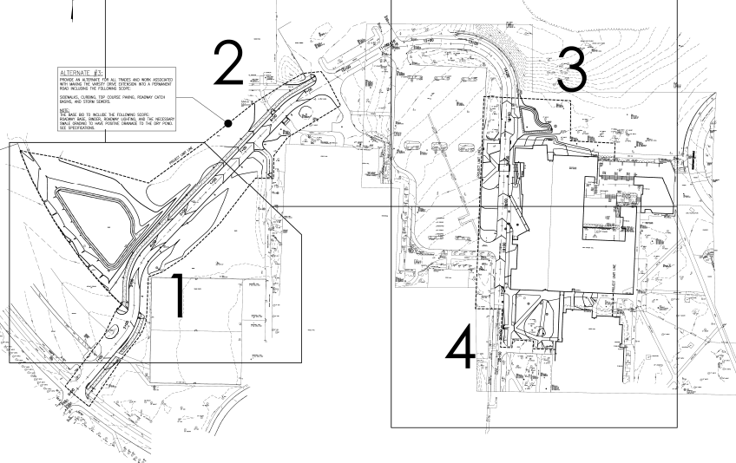
Rockefeller Arts Center
Addition and Renovation
Parking Lot 27
Varsity Drive
Parking Lot 11
Project Limit Line
New Road
RAC
Natatorium
Steele Hall
RAC Addition
Lot 9A
Dods Hall
Tennis Courts
Mason Hall
Varsity Drive
Park Drive
Ring Road
Note: New Road is Bid Alt No. 3

Slide 9
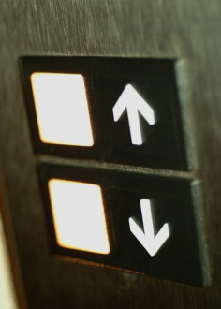
Notable Construction
Impact to Campus
Rehab/Upgrade Elevators Various Buildings
Below is the proposed schedule to start and complete the work on certain elevators
during certain periods of time.
  Summer (May thru August)2014
    Fenton Hall –Complete replacement: There is a possibility that work could spill into the Christmas Break
    Mason Hall Addition – Installation of new lift
    Thompson Hall – Complete replacement of Elevator 1 (freight elev. located at south end of bldg.)
  Christmas Break 2014 - 2015
    Fenton Hall – Remaining work from summer 2014
    Maytum Hall – Elevator 1 & 2: Rope gripper replacement
    McEwen Hall – Elevator door replacement
  Summer (May thru August)2015
    Mason Hall Addition – Complete replacement
    Thompson Hall – Complete replacement of Elevator 2 (small passenger elev. located at north end of bldg.)

Slide 10
Notable Construction
Impact to Campus
Townhouse Project (possible impact)
  Landscape work within the complex and along Ring Road
Milling & Paving - Old Main Drive & Ring Road
    Old Main Drive: Start May 19th Complete Mid June
    Ring Road (adjacent to lot 9A/9D):
    Start May 19th Complete end of May (pending completion of campus bus stop and crosswalk work at Townhouse Commons Building)
  Crosswalk and Parking Lot Striping
    Work to be Performed in May and August

Slide 11
Project Recap
Academic /Administration: [ $130.5M ]
  Science Center
  Rockefeller Arts Center Addition and Renovation
  Rehab/Upgrade Elevators Various Buildings
  Houghton Hall Rehab – Design Phase
Residence Hall: [ $32.3M ]
  Townhouse
  Disney Hall Lobby Upgrade
  Andrews Complex Window Replacement Phase One: Igoe Hall
  Interior Lighting and Occupancy Sensors – Grissom Hall /Kasling Hall
  Cleaning Limestone Window Sills – Chautauqua Hall / Nixon Hall
  ADA Signage – Hendrix Hall
  Interior Painting – Various Locations
Site Work: [ $200K ]
  Mill and Paving – Old Main Drive (Alumni to Largesse) / Ring Road (adjacent to lot 9A/9D)
  Parking Lot and Roadway Striping
MCM Projects: [ $387K ]
  Maytum Hall Mechanical Room Concrete [ $98K ]
  Mason Hall Recital Hall Reheat Boiler / Humidifier [ $59K ]
  Rockefeller Arts Center Generator Exhaust Fan [$20K ]
  Natatorium Concrete Floor Repair [ $33K ]
  LoGrasso Hall Boiler [ $30K ]
  Jewett Hall 101 lighting [ $35K ]
  Carnahan Jackson Center VAV Controller Replacement [ $35K ]
  Thompson Hall Cooling Fan / Air Handling Unit Reheat Piping [ $59K ]
  University Commons Ventilation Improvements[ $18K ]

