Slide 1
Thank You for Joining Us
While You Are Awaiting
Open the
Academic Advising Checklist
&
Log into DegreeWorks

Slide 2
Jump Start to Academic Advising
Academic Advising & Course Selection
April 6-April 17
It is a Conversation!

Slide 3
Academic Advising HAS NOT CHANGED-
It is still mandatory
IS
NOT
IS
Going to an appointment prepared to:
share information
ask questions
Going to an appointment expecting the advisor to:
create your schedule
make decisions for you

Slide 4
Student Responsibilities
Become knowledgeable about the University’s programs, policies and procedures College Catalog
Clarify personal values and goals
Prepare a list of questions or concerns
Example – Repeating a course and FA impact
Accept responsibility for academic decisions and performance
Keep a personal record of all academic progress
Follow through on suggested actions and referrals

Slide 5
What can I expect from an Academic Advisor
Communicate the University’s curriculum, requirements, policies and procedures
Help clarify options, education goals and potential
Listen carefully to questions and concerns
Assist with planning academic paths, abilities and interests
Monitor students’ progress
Talk Advising to Me

Slide 6
How to Prepare for Your Academic Advising Appointment
Make an appointment with your advisor
Will occur remotely - Faculty will provide method to sign up
Review Academic Advising Checklist (link)
Review your degree evaluation (Degree Works)
Review Fredonia Foundations (General Education courses)
Create a Draft schedule and make a list of classes you would like to take
Utilize Public Course Search
List questions and concerns

Slide 7
How to find “YOUR” Academic Advisor
Log into Your Connection
Click Student
Click Student Records
Click Advisor Information
How to find the date and time you Register for Classes
Log into Your Connection
Click on the student tab
Click Registration
Click Registration Status

Slide 8
HOLDS – Why You Might Not Be Able to Register for Courses
Example of a Hold – Financial - prevents student from registering
Please NOTE: NOT all holds prevent Registration
How to find type of hold:
Your Connection – Student Records – View Holds
Reason for hold will be listed
Contact department or office ASAP
Still complete academic advising if you have a HOLD
This allows you to register for your classes as soon as your hold is removed

Slide 9
Degree Works
HTTP://WWW.FREDONIA.EDU/REGISTRAR/DEGREEWORKS.ASP
*Develop the habit of always processing new*
To make sure your degree audit is the most current
Useful Features:
What If
Looking to:
Change major
Add concentration
Add Minor
Click ‘What if’
‘Pick an Academic Year’
After picking a major, minor or Concentration, click ‘Process What-if’
Look Ahead
Nothing is Official until documentation is submitted to Registrar's Office
Things to be aware of:
45 Credit Upper Level Requirement
120 Credits (minimum) for degree completion
Credits outside your Major
Fredonia Foundations (FF):
Themes & Categories
map out carefully
many courses fall under “Critical Thinking & Innovation”
Transfer students are not required (but encouraged) to complete themes
Be aware of major requirements that also satisfy Fredonia Foundations (Double Dip)
Notes:
Degree works will update overnight
If any information is inaccurate or not showing, contact registar ASAP
Pay attention to 45 credit requirement for 300 level and above courses
Recommend doing a degree audit at 60 to 75 credits – make sure on track to graduation

Slide 10
Fredonia Foundations
Oral Communication (many majors have a course requirement that fulfills this category)
Written Communication = ENGL 100
Mathematics (many majors have a course requirement that fulfills this category)
5 courses, one from each category:
Arts
Foreign Language
Humanities
Natural Sciences
Social Sciences
2 courses, one from 2 of the 3 categories:
American History
Western Civilization
Other World Civilizations
ADD IN THEMES INFORMATION

Slide 11
Check for Transfer Credit
Transfer, IB, or AP Credit
Was a transcript submitted from previous school?
View Credit Evaluation: Your Connection – Student Tab – Transfer Evaluation
Make sure everything is accurate
Contact Office of the Registrar for questions
Registrar@fredonia.edu

Slide 12
Choosing and Adding a Minor
Discuss minor options with your advisor.
Refer to the catalog for a list of minors.
Process a minor “what if” in degree works.
Pay close attention to the classes required
Investigate whether there are “double dipping” opportunities.
Contact the department to discuss a minor in depth – make an appointment with the department chair.
How to declare a Minor

Slide 13
Common Errors When Registering for Courses
Class Restriction i.e. Field of Study Restriction
Departmental Approval
Prerequisite Error
Reserve Closed
Closed Section
*Not all courses are offered every semester*
Notes:
Class Restriction – Field of Study Restriction: SPMG 210
Departmental Approval – SPMG 400 (Internship)
Prerequisite Error – SPMG 218: Need CIST 104 or CSIT 151
Reserved Closed – Reserved Seats: PSY 129 (required course/prerequisite)
Closed Section: SPMG 305

Slide 14
Basic Requirements to Graduate
120 Credits
Minimum GPA of 2.0 (though some majors have a higher GPA requirement)
Completion of all required courses in the Major
Completion of all General Education Requirements
No more than 4 credit hours of P.E. courses
45 credits at the upper level
Minimum of 45 semester hours at Fredonia

Slide 15
Important Dates
April | 2 | Thurs | Mid Semester Grades Available to Students
April | 6-17 | Mon-Fri | Academic Advising & Course Selection
April | 14 | Tues | Undergraduate Registration Begins
April | 27 | Mon | Final Day to WITHDRAW from Full Courses*
April | 27 | Mon | Last Day to Completely Withdraw from the University
May | 8 | Fri | Last Day of Classes
May | 11-15 | Mon-Fri | Final Exam Week
May | 21 | Thur | Final Grades Available to Students after 3:00pm
Notes:
Jump Start to Advising
What and when is Academic Advising and Course Selection
Academic Advisor
How to register for classes
What classes students should register for?
Registration Celebration
Assistance with registering for Fall 2918
Bring registration and advising worksheet signed by advisor
Navigate the registration process, logging-in, registration issues and concerns
Dates and times TBD

Slide 16
Things to Keep in Mind
MWF= Monday Wednesday & Friday
TH= Tuesday & Thursday
Transfer Credit Approval Form
Final day to withdraw from classes - April 27th
How to Change your major
12 Credits is Full Time-Goal would be 15 Credits
How to register for classes
How to search for classes

Slide 17
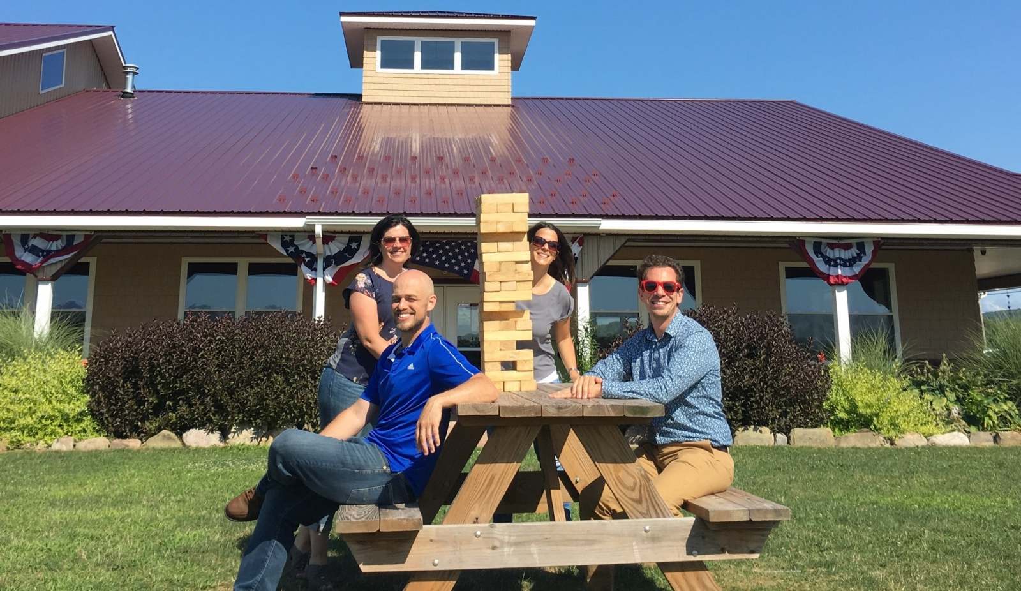
Academic Advising Services
advising@Fredonia.edu
Josh Croxton
Transfer Academic Advisor
Nicole Hohenstein
Early Alert Coordinator/ Academic Advisor
David Phillips
Academic Advisor
Amy Marshall
Director of Academic Advising

