Slide 1


Going on a Business Trip?
An Overview of Travel Guidelines (Policy #810)
Notes:
You can’t just go… We need to know. Before starting, talk about upcoming changes to travel page, policies, forms, etc. Also, mention that this is a general overview and, due to time restrictions, will not cover everything. It is the employee’s responsibility to know all travel guidelines. Not knowing a rule or regulation does not mean it doesn’t apply to you.

Slide 2
DETERMINING TRAVEL STATUS
Are you traveling more than 35 miles from both your official work station and home?
If “No,” you are most likely not entitled to reimbursement as this is not considered Travel Status.*
If “Yes,” you are eligible for reimbursement as you are considered in Travel Status.
*Exceptions can include mileage reimbursement for supervision of student teachers, Admissions, etc.
Notes:
Don’t forget to mention the Lesser of Mileage rule which applies to proximity travel from OSC.

Slide 3

Complete a
Travel Authorization
A Travel Authorization (TA) should be completed four weeks prior to leaving on your trip.
Complete ALL fields on the TA.
List ALL funding sources on your TA.
That includes, but is not limited to, Other Funds such as Research, Foundation and FSA.
Use the Per Diem Rate Quick Link on the Travel Page to determine rates for the location you will be staying.
Record these on your TA.
Submit TA to your Supervisor for approval. You may also need a signature from the funding account’s Authorized Signer (if seeking funds from another department), Dean, or VP.
Notes:
Don’t forget to mention that TAs are required for ALL trips. Even if you are traveling from campus to the Incubator, you are supposed to turn in a TA. Short distance TAs are for insurance purposes only and don’t need to be turned in to Accounting, but kept on file within your department. You also want to include your Over Per Diem Lodging Justification and Personal vs. Rental Vehicle Comparison forms.
$500+ requires Dean’s approval. $2,500+ requires VP approval.

Slide 4

Always Know Your Trip Allowance
It is VERY important that you know how much you will be allowed to spend BEFORE you go on your trip.

Slide 5
Travel and NET Cards
The university’s preferred and most efficient method of payment for travel-related expenses is via the state-issued JPMC Travel and/or Non-Employee (NET) Card.
Use of a Travel or NET card requires an application and a signed agreement to abide by the rules and regulations set forth in that agreement.

Slide 6

TRAVEL CARD
Used for Employee Only Travel Expenses.
The Travel card may be used when the employee is in “Travel Status” while on official State University business only.
Travel cards may only be used to pay for travel for the employee whose name appears on the card.
Employees may not use travel cards to make personal purchases, even if they intend to reimburse the State for those expenses. In addition, travel cards must not be used to pay expenses that are not travel-related.
ONLY the person whose name is embossed on the card is authorized to add expenses to that card.

Slide 7

NET CARD
Used for Non-Employee Travel Expenses.
The NET Card is used to pay for travel expenses for non-employee travel on official State University business only. You may not use this credit card for personal charges or for any New York State employee travel.
There is one exception, which allows a New York State employee’s travel to go on the NET Card. If coaching staff is traveling with the team or instructional staff is traveling with a group of students for a course or group activity the New York State employee’s expenses may go on the NET Card. If the New York State employee is not in “Travel Status” and the majority of the team or group is NOT comprised of non-employees, the New York State employee’s expenses must be out-of-pocket payments.
ONLY the person whose name is embossed on the card is authorized to add expenses to that card.

Slide 8
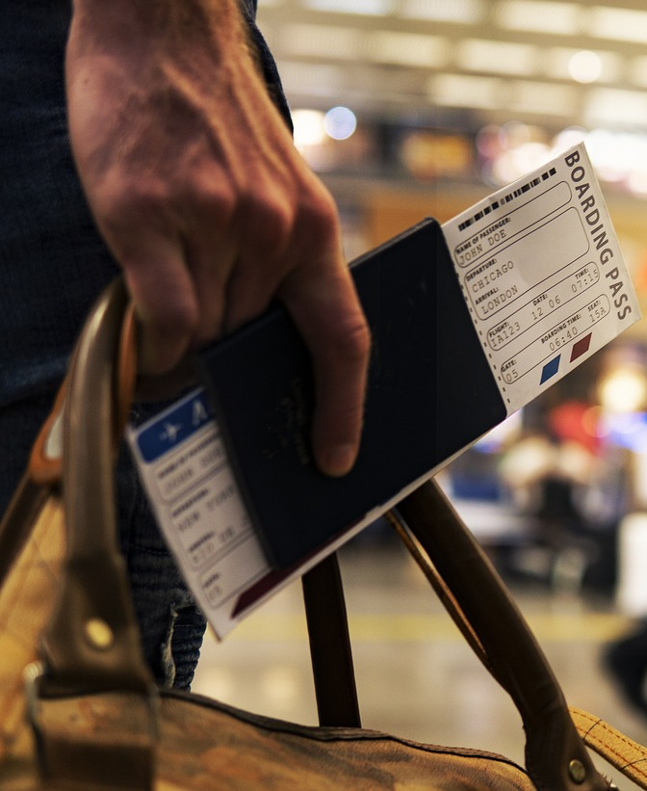
Travel/NET card may be used for:
Commercial transportation
Rental vehicle
Lodging
Meals (as detailed below)
Registration/Conference fees
Taxis/Parking
Subway
Fuel (when not using personal vehicle)
Visa/Passport
Historical/Cultural Site/Museum
Miscellaneous expenses while in travel status
Telephone Charges (related to official State business)
Unanticipated work supplies
Travel/NET Card should not be used for:
Fuel for personal vehicle
Food expenses for staff meetings and retreats
Personal use of any kind
Travel Upgrades of any kind
Alcoholic beverages
Incidentals on hotel bill (gym/spa charges, and movie rentals)
Cash advances
Purchasing Meals with Travel/NET Card:
If cardholders choose to use the Travel Card to pay for meals, the allowance for meals, including gratuities shall be limited to actual cost up to the maximum Per Diem meal allowance. An itemized receipt for meal purchases is required. Alcoholic beverages cannot be paid with Travel/NET Card.
Notes:
Even when using a Travel or NET card, meals should be kept at or below the allowed per diem for the trip. If the amount spent on meals exceeds per diem, the traveler will be responsible to reimburse SUNY Fredonia for the overage.

Slide 9

MISUSE OF TRAVEL/NET CARDS
1st Offense: Employee will be notified via email of the misuse.
2nd Offense: Employee, their Supervisor and The Internal Control Officer will be notified. The Internal Control Officer will send a letter to cardholder (CCing their supervisor and HR) directing them to schedule a counseling session, which will include another mandatory training session with the Travel Administrator.
3rd Offense: Employee’s Travel/NET Card will be terminated and other disciplinary actions may be taken by HR, which could include termination of employment.
Any misuse of the Travel/NET Card will also result in the employee reimbursing the un-allowable expenses to the Campus.

Slide 10

Transportation
Travelers should use the most efficient and cost-effective method of transportation available. Often, this means using a common carrier such as an airplane, train, bus or taxicab. The choice of transportation method must be in the best interest of the state. Travelers should obtain the lowest cost coach equivalent accommodations available.

Slide 11
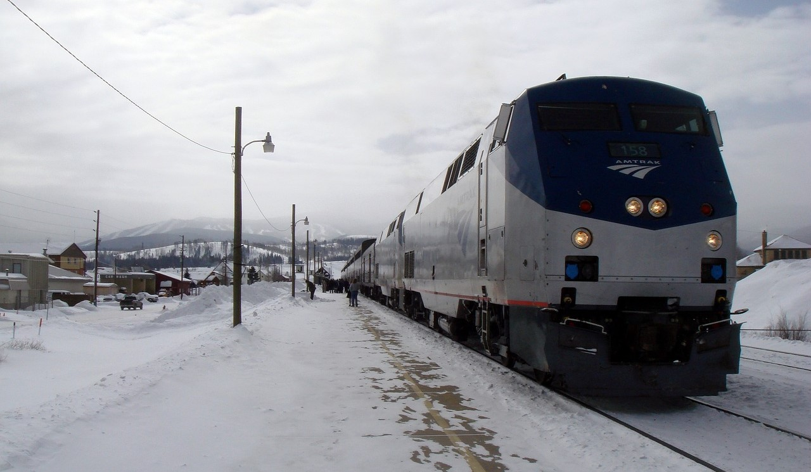
Airfare & Amtrak
Purchase airfare and Amtrak fares with a state-issued credit card through Direct Travel's Concur software.
Only coach or economy fare is reimbursable.
Pre-boarding fees are not reimbursable.
Airfare cost comparison may be necessary to justify method of transportation, times of travel, or if personal travel is combined with business travel.
Rail travel in excess of 200 miles one way may be business class.

Slide 12

Rental Car
IMPORTANT!
Rental vehicles should be returned with the same level of fuel as when taken out. Refueling fees from rental agencies are not a reimbursable expense and, should they be charged to a State issued card, the cardholder would be responsible for reimbursing Fredonia that cost.
When the use of a rental vehicle is necessary, prudent and less expensive than common carrier, travelers should use the New York State Enterprise/National or Hertz Rental Contracts.
When renting a vehicle for State business, the traveler should rent in the name of New York State and sign the agreement as an agent for the State.
Up to a “standard” size vehicle rental is allowable. If larger vehicle is required, written justification must be included with rental car receipt.

Slide 13
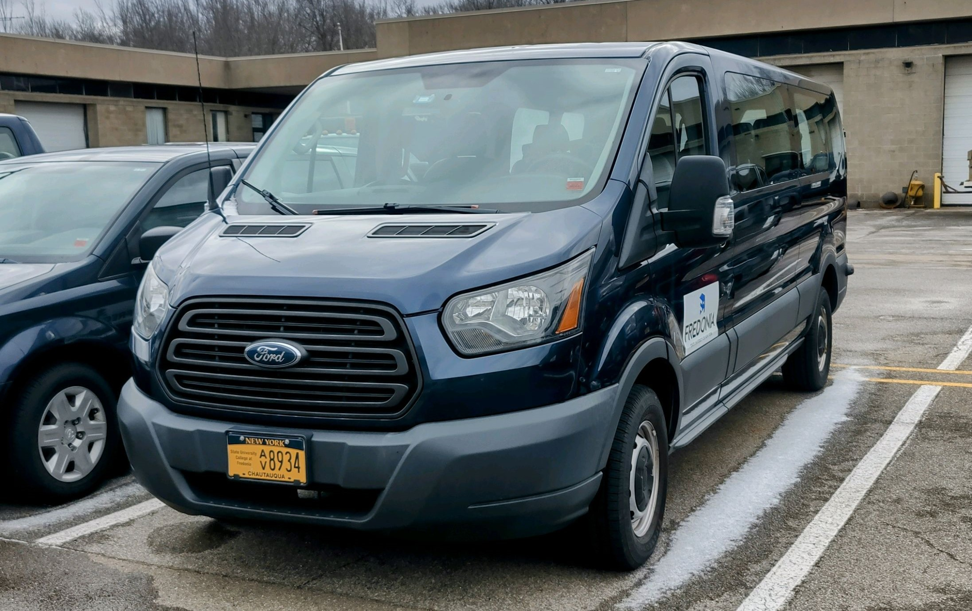
University Vans
Only groups of 5 or more may request use of a van via the Facilities Services webpage. If traveling with non-employees a NET card must be used for fueling. When traveling with a group of State employees, the Travel card or personal funds (which are reimbursable) should be used for fuel.

Slide 14

Personal Vehicle
CURRENT MILEAGE REIMBURSEMENT
$0.70
May be used when a State vehicle, common carrier or rental car is not available, is not cost effective or is otherwise not appropriate.
Charges for gasoline, oil, accessories, repairs, depreciation, anti-freeze, towing, insurance and other expenditures will not be allowed. These are considered operational costs and are covered in the mileage allowance.
All reasonable and necessary parking charges will be reimbursed. Valet parking fees will only be reimbursed if it is an unavoidable expense (for example, when the hotel only offers valet parking).
A Personal versus Rental Vehicle Comparison form MUST be completed for any trip greater than 100 miles round-trip and should be turned in with the traveler’s Travel Authorization.

Slide 15

FOREIGN TRAVEL
All travel outside the Continental US and Canada (or over $2,500) must be pre-approved and the Travel Authorization Form received in the Accounting Office four weeks PRIOR to the trip Departure Date. The Travel Authorization Form for these trips MUST be approved via signature by the President or the division Vice President (or their designee).

Slide 16

FOREIGN TRAVEL
Continued…
Reimbursement amount is based on the maximum per diem allowance established by the U.S. Department of State. The rates are posted on the http://www.gsa.gov web site. Expenses should be converted to American dollars, based on the exchange rate in effect during the period of travel.
The foreign travel rates provide for lodging costs up to a maximum amount, and an allowance for meals and incidental expenses. If a traveler is entitled to the full meal per diem, the allowance is divided into 80% for dinner and 20% for breakfast.
The passport rules are changing. It is the traveler’s responsibility to know the document requirements of the country they are traveling to!

Slide 17

FOREIGN TRAVEL
Continued…
Expenses directly related to lodging and meals are included in the foreign per diem allowance; however, some expenses unique to foreign travel may be reimbursed at the discretion of the agency, such as:
  Passport fees
  Visa fees
  Cost to convert currency
  Traveler’s checks fees
  Laundry charges for extended stay
  Departure taxes

Slide 18

Reimbursement: Method I or Method II?
METHOD 1
METHOD 2
This is a FLAT RATE per diem allowance for meals, lodging and incidentals.
Works well when lodging has been obtained at no charge (ie: staying with relatives or friends).
Regardless of stay, zip code of lodging is required.
No meal or lodging receipts required.
MUST be used if employee is not staying in a hotel.
Provides a meal allowance for breakfast and dinner based on federal reimbursement rates for the location of travel. (Lunch is NOT reimbursable by NYS.)
A lodging receipt is required to claim this Method.
Meal receipts are not required to claim meal per diems.
Must provide ORIGINAL, ITEMIZED receipts for all amounts charged to Travel/NET card.

Slide 19
2024 Per Diem Rates: Method I vs. Method II
IMPORTANT NOTE!
When calculating meal reimbursements, ONLY the GSA M&IE total amount is utilized. First and last day, along with other amounts under the ‘Meals & Incidentals rates and breakdown’ heading are not to be used. Also, meal reimbursements are calculated by OVERNIGHT trip. This means that an overnight per diem consists of a dinner on the first night and a breakfast on the next morning and so on. (Ex: If you stay three days and two nights in Orlando where the per diem rate is $69 AND assuming you are not entitled for the extra breakfast the day of departure or the extra dinner the day of return AND you provided your lodging receipts, your total meal reimbursement would be $138 or 2 nights x $69.)
 | METHOD I |  | METHOD II
Location | Meal Per Diem | Lodging | Meal Per Diem | Lodging
NYC | $50 |  | $79 | Between $169-$258 (Depends on month*)
Nassau, Rockland, Suffolk and Westchester Counties | $50 |  | Between $69-$74 (Depends on county*) | Between $126-$151 (Depends on county*)
Albany, Binghamton, Buffalo, Rochester, Syracuse and their respective surrounding metropolitan areas | $40 |  | Between $64-$69 (Depends on City*) | Between $113-$119 (Depends on city*)
All other locations in New York State | $35 |  | Varies by location* | Varies by location*
Outside of New York State | $50 |  | Varies by location* | Varies by location*
Breakfast on Morning of Departure: Available to a traveler if they must leave at least one hour prior to the start of their normal work hours. Method I grants $5. Method II is 20% of meal per diem rate.**
Dinner on Evening of Return: Available to a traveler if they return from their trip at least two hours after their normal work hours. Method I grants $12. Method II is 80% of the meal per diem.**
*Refer to GSA website for exact per diem rates.
**These amounts are available for both overnight and day trips. NOTE: meals on day trips are taxable.

Slide 20
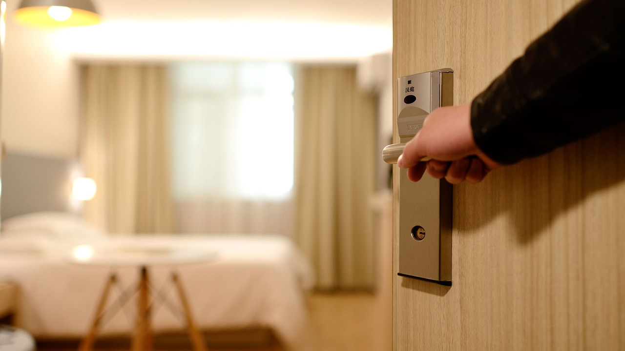
Lodging
The allowable per diem room rate should be obtained whenever possible.
  If not obtainable, the traveler must complete an Over Per Diem Lodging Justification form.
Lodging provided by a third party is not reimbursable.
  Method I meal reimbursement will be used if lodging receipt is not obtained.
For Candidates and Guests to SUNY Fredonia, verification of no on-campus rooms MUST be provided prior to contacting the Clarion or other local hotels.
Personal room expenses (movies, mini bar, etc.) are not reimbursable.

Slide 21
RECONCILING YOUR TRIP
IMPORTANT DATES
Employees seeking out-of-pocket reimbursement have 30 BUSINESS days after the Return Date showing on their Travel Voucher in order to receive reimbursement.
There are no exceptions to this rule!!
Fredonia is more restrictive than OSC by electing to NOT reimburse out-of-pocket expenses if paperwork is not received in Accounting/Accounts Payable within 30 business days.
Per OSC, we must treat all travelers by the same travel rules.
Employees who have a state-issued TRAVEL and/or NET Card must have proper documentation turned in prior to the due date of their card statement. If the cardholder misses the release date, their monthly Spending Limit will be dropped to $1, until such time that reconciliations are 100% complete.
It is the employee's responsibility to monitor the workflow of their paperwork.

Slide 22
TRAVEL VOUCHER
A Travel Voucher is REQUIRED for EACH trip.
Complete:
ALL blue sections on the Travel Voucher.
2) Attach:
ORIGINAL, ITEMIZED receipts.
An agenda, program or other documentation to substantiate all travel expenses or days expenses are claimed.
Mileage Statement for Personal Automobile Use (if applicable).
Over Per Diem Lodging Justification Form and Personal vs. Rental Vehicle Comparison (if applicable and not provided with TA).
3) Obtain:
Supervisor’s signature
Last, but not Least:
Turn in ALL paperwork to the Travel Administrator within the required amount of time to ensure speedy processing and no repercussions.
Notes:
If your trip spans more than one CC statement, multiple Travel Vouchers will need to be turned in. Please mark TV as either partial or final to let Accounting know if more receipts, etc. for your trip are coming.

Slide 23

REMEMBER
All travel must:
Be in compliance with the rates and regulations listed here, which follow Federal, New York State, SUNY, and Fredonia rules and regulations.
Be for official State business and in the best interest of the State.
Include only actual, necessary and reasonable business expenses.
Be conducive to achieving the objectives of the trip while balancing factors such as least expensive, time and safety.
Be pre-approved via written documentation.
NYS Sales Tax is NOT reimbursable!
If staying in a hotel, don’t forget your NYS Exemption Certificate for Tax on Occupancy of Hotel or Motel Rooms (ST 129) or New York City Tax on Occupancy Tax Exempt or NYS Tax Exempt Certificate (AC946) forms.
ENJOY YOUR TRIP!

Slide 24

QUESTIONS?

Slide 25




THANK YOU
Trenton Lutes
x3467
Trenton.Lutes@fredonia.edu
Questions? Please contact the Accounting Department

