Slide 1




Time and Attendance System for
Student Employees

Slide 2
Overview of Time and Attendance System (TAS)
For Student Employees
Sign –in to SUNY HR Time and Attendance using existing User ID and password.
Select an Accrual Period (Pay period)
Enter Time In and Time Out for each day worked.
Certify and Submit Time Record to your Supervisor.
Sign-out of SUNY Browser and Close

Slide 3
First-time System Sign-in Information
For security reasons your sign-in will be different the first time you enter into the Time and Attendance System. You will be asked for your SUNY ID (which is provided by your campus) and your date of birth (DD/MM/YYYY).
Once you complete this security procedure, you will not need to verify your information.

Slide 4
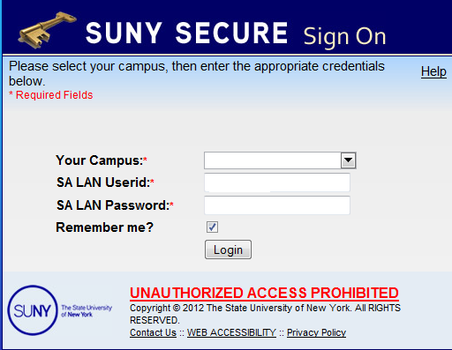
Sign in to SUNY at: http://www.suny.edu/time
Bookmark
As described in the previous slide, the screen will be slightly different your first time signing in, requesting your SUNY ID and DOB. That is a one-time security occurrence. Going forward, your entry screen will look like this:
User ID and Password

Slide 5
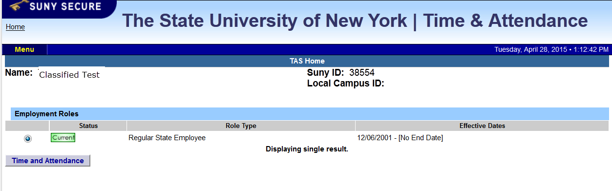
Once logged into TAS, the home page will be displayed. This includes employee information and employment roles. To begin using TAS, click on
“Time and Attendance” tab.

Slide 6
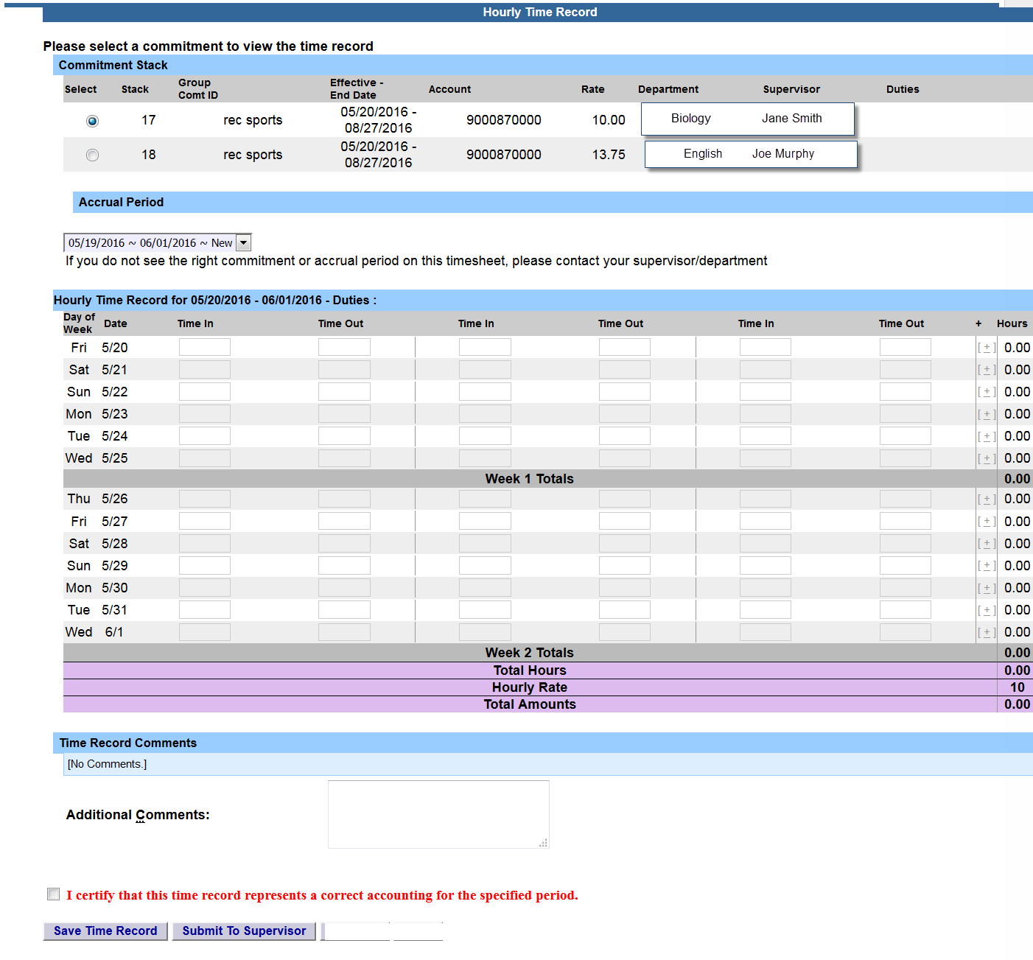
Time record:
If you have multiple commitments, please select commitment stack with appropriate department, supervisor and rate in which you need to enter time worked.
Then select the accrual period in which you will be entering your time for. Accrual period status:
  New – new time record
  Working – working on time record
  Pending – submitted to supervisor and awaiting action.
  Approved – supervisor approved time record
  Denied – supervisor denied time record
Enter the accurate time in/out per day, multiple times a day if needed. Please enter “A” for AM and “P” for PM. . Click on Save Time Record after each entry.
Enter comments in the box indicated below if you wish to submit comments to your supervisor on your time record.
Once your hours of obligation has been completed and entered for the pay period, please check the box certifying the information that has been entered is accurate and then click on submit to supervisor. NOTE: You will receive the pop up message if you navigate away from your time record in which changes were made and was not save or submit to their supervisor.
Once you have submitted your time record to your supervisor, the status will change to pending until approved.
Total Hours – total number of hours entered within the pay period.
PDF Report - Printable time record.
Audit Details of when time records have been submitted and action has been taken.
Accrual Period
Enter Time in and Time out in open fields.

Slide 7
Warning/Error messages within TAS:
Warning & Error Messages:
Warnings:
Total work hours across duties exceed 20 hours
Total work hours across duties exceed 29 hours
A break in work hours is required if a work day is longer than 6 hours continuously.
You have entered only time in for one or more work period(s). Please enter corresponding time out before submitting the time sheet.
You cannot approve an incomplete timesheet. In one or more of the work period(s), only time-in is entered (for supervisor only).
You cannot approve or deny an empty timesheet (for supervisor only).
Payments with overlapping dates exists in this pay period.
Total payment amount ($) is close to or exceed the award amount (TAS Payment Roster only).
Errors:
The fiscal year associated with this timesheet has ended. Please contact your HR Department for payroll processing (for student only).
Please deny this timesheet. The fiscal year associated with the timesheet has ended. Student employee must contact HR Department for payroll processing (for supervisor only).

Slide 8
Notifications:
For the supervisor:
You have a pending student time record needing your review and action.
If a supervisor does not take action on the employee’s time record within the timeframe specified by the campus, the time record will be moved up to the supervisor’s supervisor.
For the student if the time record is denied by either the supervisor or by the payroll department from the TAS Payment Roster:
Your Time Record has been disapproved. Please log in to review the denial comments.

Slide 9
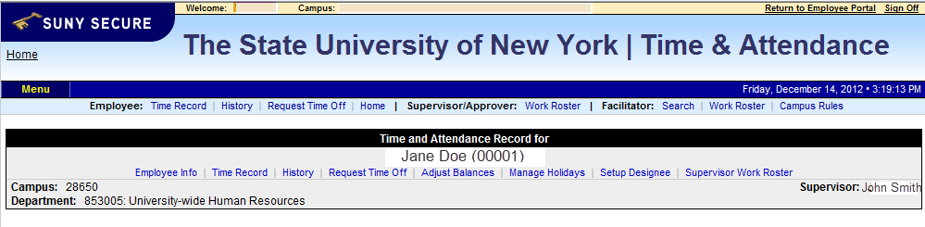
Sign out of the SUNY browser and CLOSE
To ensure your privacy and system security, please log off by clicking on “Sign Off” link in the upper right hand corner of your screen.
Sign Off

Slide 10
CONGRATULATIONS!
For those of you without direct reports, once you have entered your current Time and Attendance Information, you have successfully completed the training session.
Step by Step instructions are also available for your use.
Supervisors, there are a few more slides about the process for approving time records and/or time off requests for your employees.

Slide 11
Time and Attendance System (TAS)
Supervisors
Step-by-Step

Slide 12
Overview of Monthly Time and Attendance Process – For Supervisors
Sign in to SUNY HR Time and Attendance
Select “Work Roster.”
View employee’s Time Record
Select “Details” to view employee’s time record.
Select “Approve” or “Deny”

Slide 13
Sign in to SUNY at: http://www.suny.edu/time
Bookmark
As described in a previous slide, the screen will be slightly different the first time you log in, requesting your SUNY ID and DOB. That is a one-time security occurrence. Going forward, your entry screen will look like this:
Suny ID and Password

Slide 14
Then, click on
“Time and Attendance” Tab to get into your time record

Slide 15
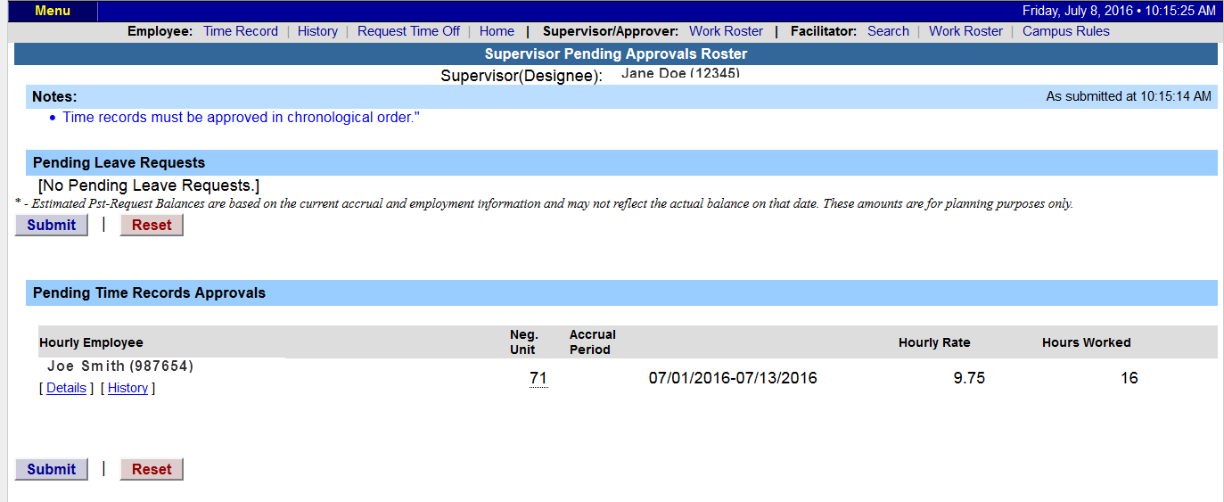
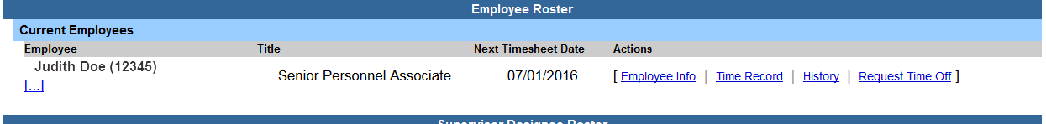
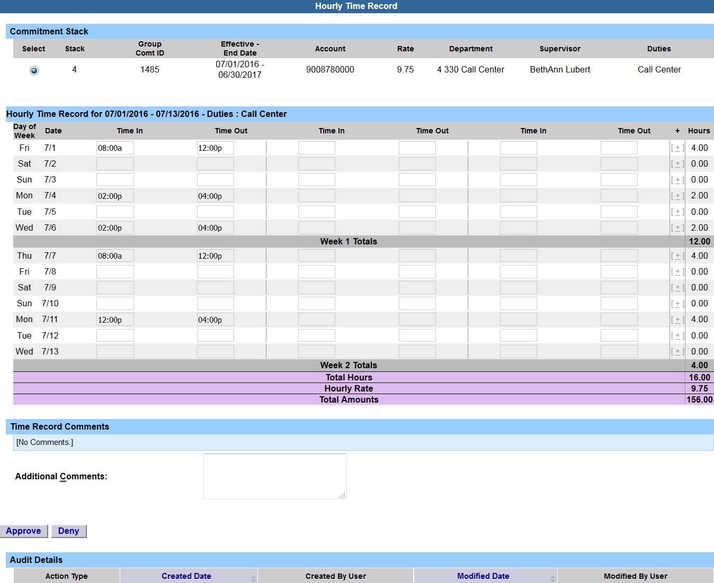
      Supervisor Work Roster:
Work Roster
Click on Work Roster, to view pending time records for your employees.
If you have multiple employees reporting to you in different bargaining units, they will be displayed separately on your work roster for your convenience.
  Unclassified Employee
  Classified Employees
  Hourly Employees
Select “Details” under Pending Time Records Approvals to view time record to take action on.
Under the Employee Roster, if […] icon appears under an employee’s name, this indicates the employee is also a supervisor within the department. If you click on the […] icon their supervisor work roster will be brought up, and you have all the same supervisor privileges.
To take action on a pending time record once the supervisor has clicked on details from the work roster and reviewed the time record, please click approve or deny.
Once action has been taken, the pending time record will be removed from the work roster.
If approved, the time record will change to an approved status under the accrual pay period drop down.
If Denied, the time record will show as denied with required comments for the employee to correct as necessary and resubmit to supervisor.
If time record has been approved, the total hours worked will roll into the TAS Payment Roster for the payroll department to audit and send the payment to OSC.
View Details or History of Time Record
Approve/
Disapprove

Slide 16
Sign out of the SUNY browser and CLOSE
To ensure your privacy and system security, please log off by clicking on “Sign Off” link in the upper right hand corner of your screen.
Sign Off

Slide 17
Thank You!
Step by Step instructions are also available for your use.
Please contact any member of the HR Time and Attendance implementation team if we can be of further assistance.

