Slide 1


Welcome
Time and Attendance
Payroll Office

Slide 2
Background
The new system has been developed by SUNY System Administration and is part of SUNY's five-year technology plan.
Features and Benefits:
  Completely paperless system - supports our "green" campus initiative and saves paper and printing of time records.
  Provides an electronic approval workflow.
  Increased efficiencies, accuracy, and up-to-date accrual balances.

Slide 3
Overview of the Basic Process
Credit Your Holidays
Be sure to give yourself credits for Holidays worked
Record Time Off Work
Certify and Submit
Certify (Your Electronic Signature)
Submit to Supervisor
Log-off AND Close Browser
Any time you did not report to work should be reflected on the Calendar view in quarter day increments (.25, .50, .75 or 1)

Slide 4
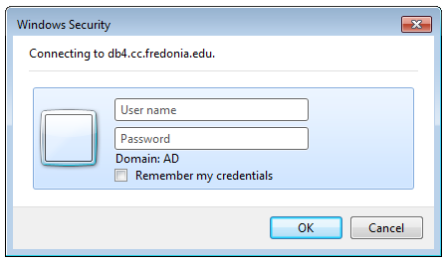
Before You Begin…
You will need your SUNY ID
  This is for use on the one-time security screen, if prompted for it. You will not need to remember it or use it again for this purpose
To obtain your SUNY ID:
  Click on the link:
    https://data.fredonia.edu/Reports/Pages/Folder.aspx
If you are asked to log on, use your eServices ID (ad\eServicesID) and the password you use to log on to your computer each day.

Slide 5
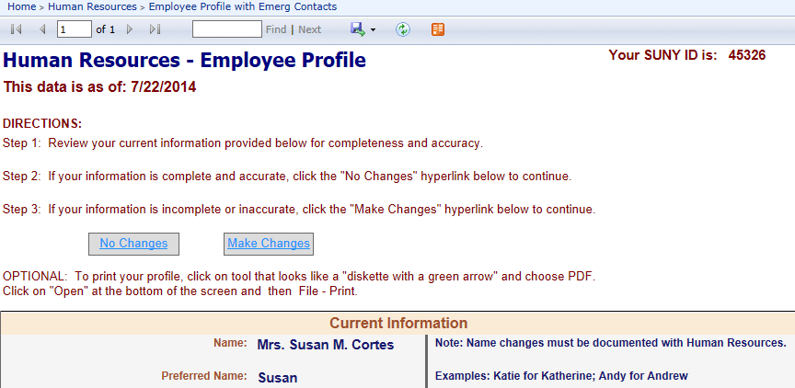
Then click on the “Human Resources” folder.
Then click on the “Employee Profile with Emerg Contacts” report.
Each person will be looking at his/her own data only.
The SUNY ID is in the upper right corner of the report

Slide 6
Electronic Time and Attendance
STEP-BY-STEP

Slide 7
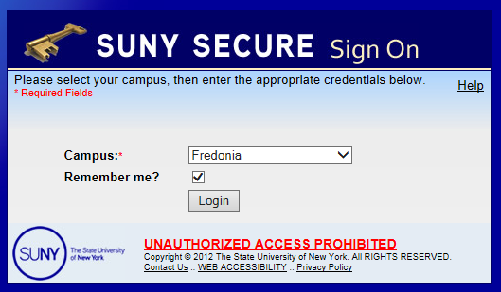
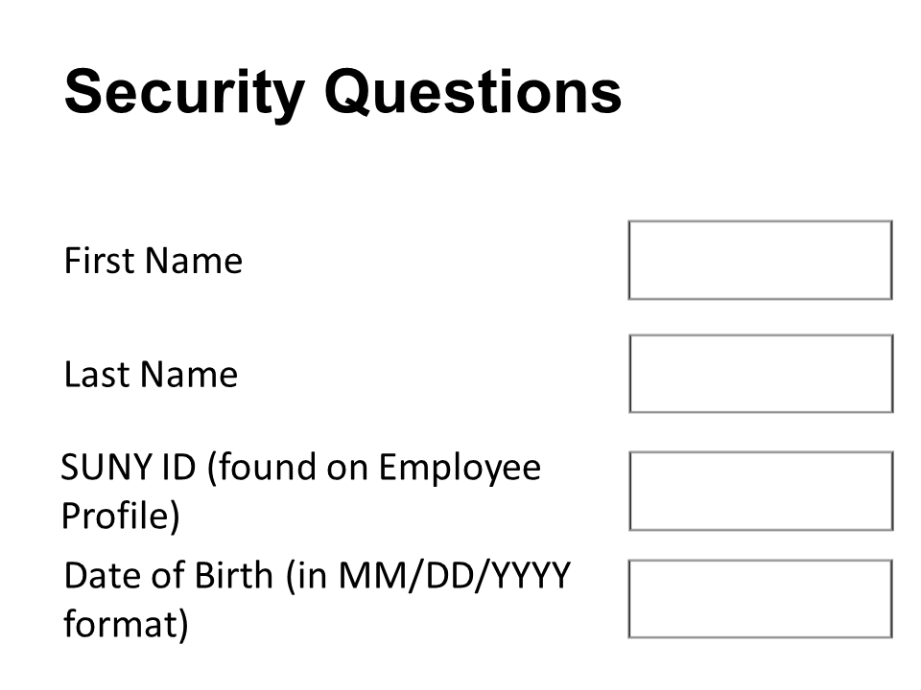
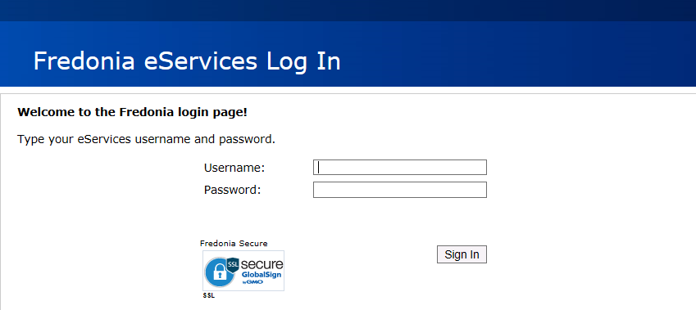
Access to SUNY HR will be found at: https://www.suny.edu/hrportal
You will need to use Internet Explorer as your browser
First:
One-time Security Screen
Second:
Sign-On
For security reasons your sign-in will be different the first time you enter SUNY Time and Attendance:
User ID and password – same as used to sign on computer each day

Slide 8
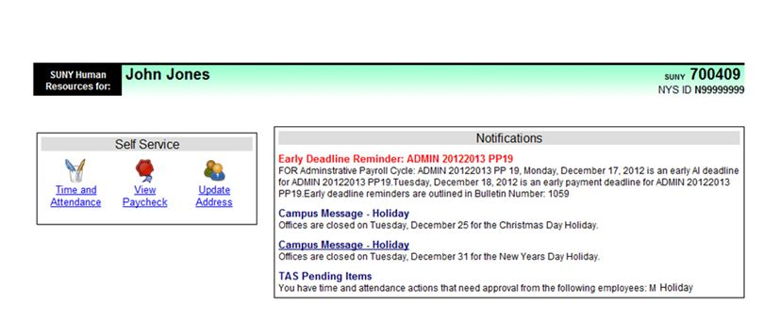
To Enter, Click on the
“Time and Attendance” Tab
Your pay stub can be viewed through the “View Paycheck” feature as of the Monday preceding any payday.
In addition, a two-year payroll history has been loaded for your information.

Slide 9
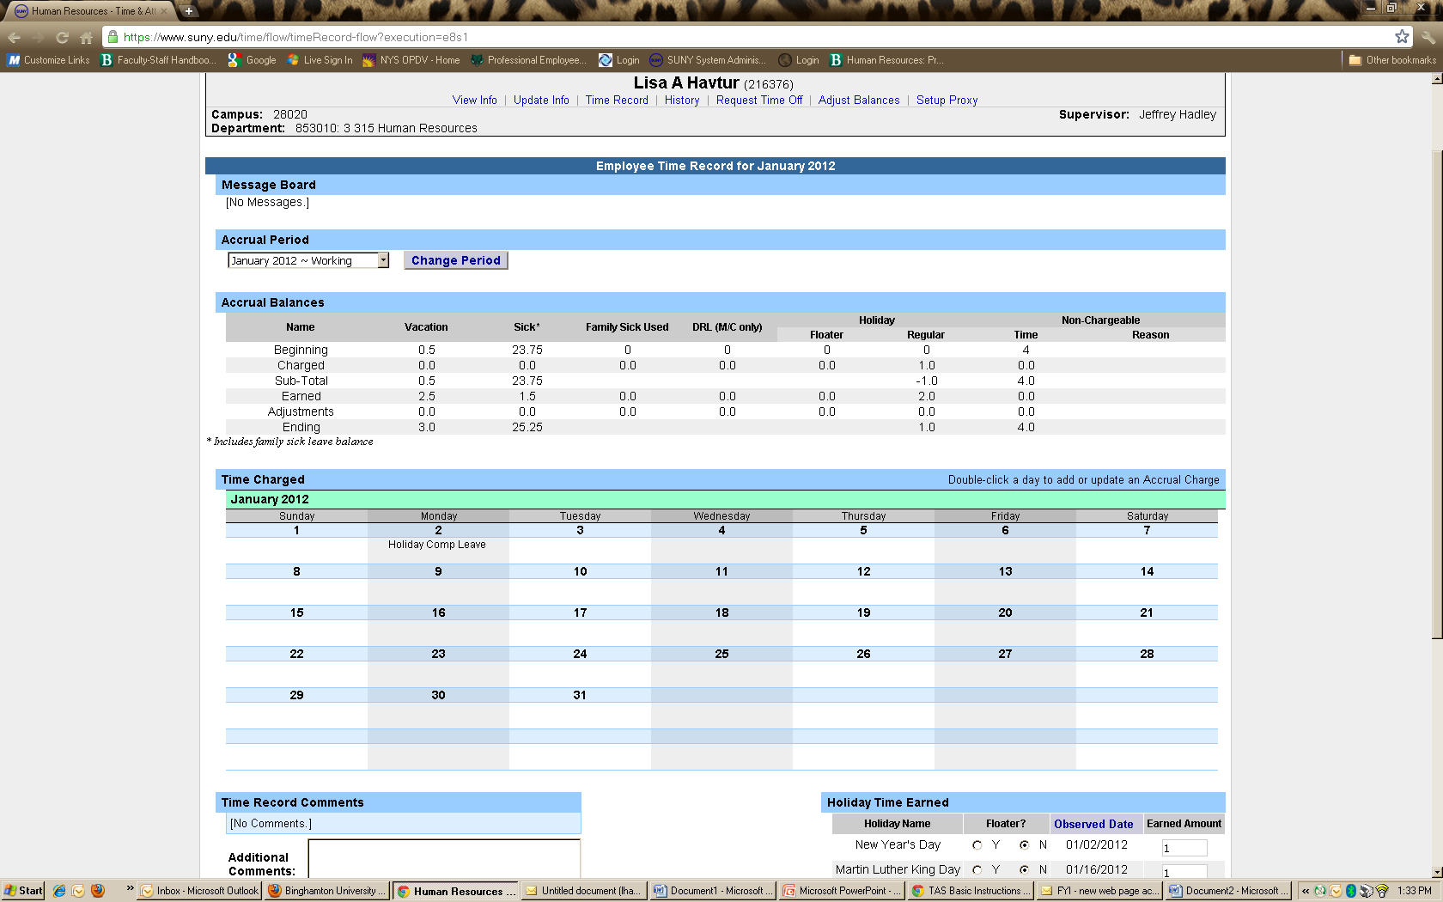
Next, Select Month(Accrual Period)
Current Month (or Accrual Period) comes up automatically
The status of any given month is reflected here in the above drop-down:
Working: Open for you to make entries
Pending: Submitted to your supervisor
Approved: Reflected once Supervisor has signed-off

Slide 10
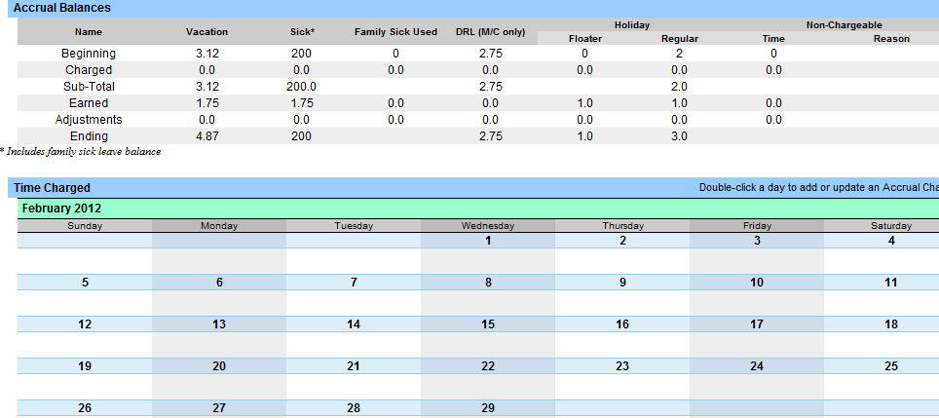
Accrual Balances & Charges
Family Sick Leave tracked here, deducted from Sick Leave. Family sick charges relate to medical care of a direct family member.
Non-chargeable time (such as conferences, jury duty)
Tracked here, not deducted.

Slide 11
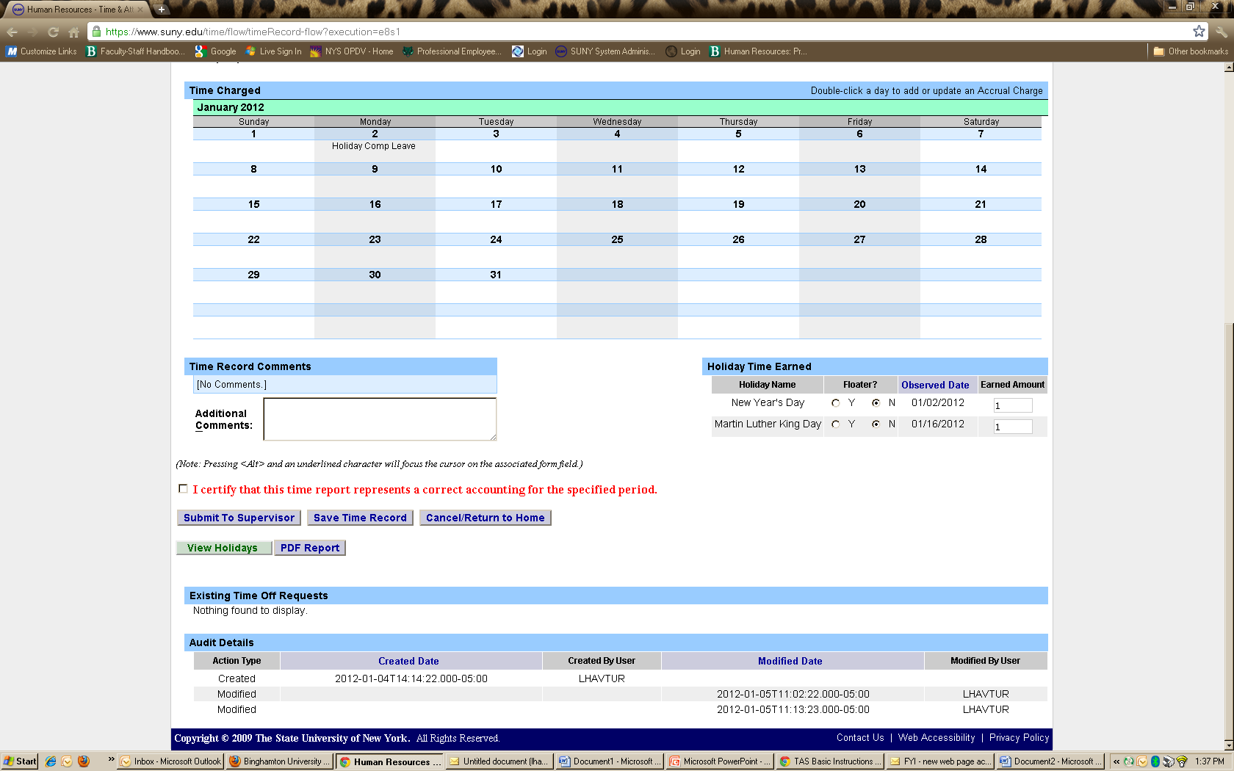
Enter Holiday Credits For Each Holiday Worked –THEN SAVE!
1) Enter credit due for each eligible Holiday worked.
2) Then save

Slide 12
Enter Charges for Vacation, Sick, or Other. THEN SAVE!
1) Enter charges for time used
Quarter-day increments ONLY may be used:
.25
.50
.75
1.00
2 )Then save

Slide 13
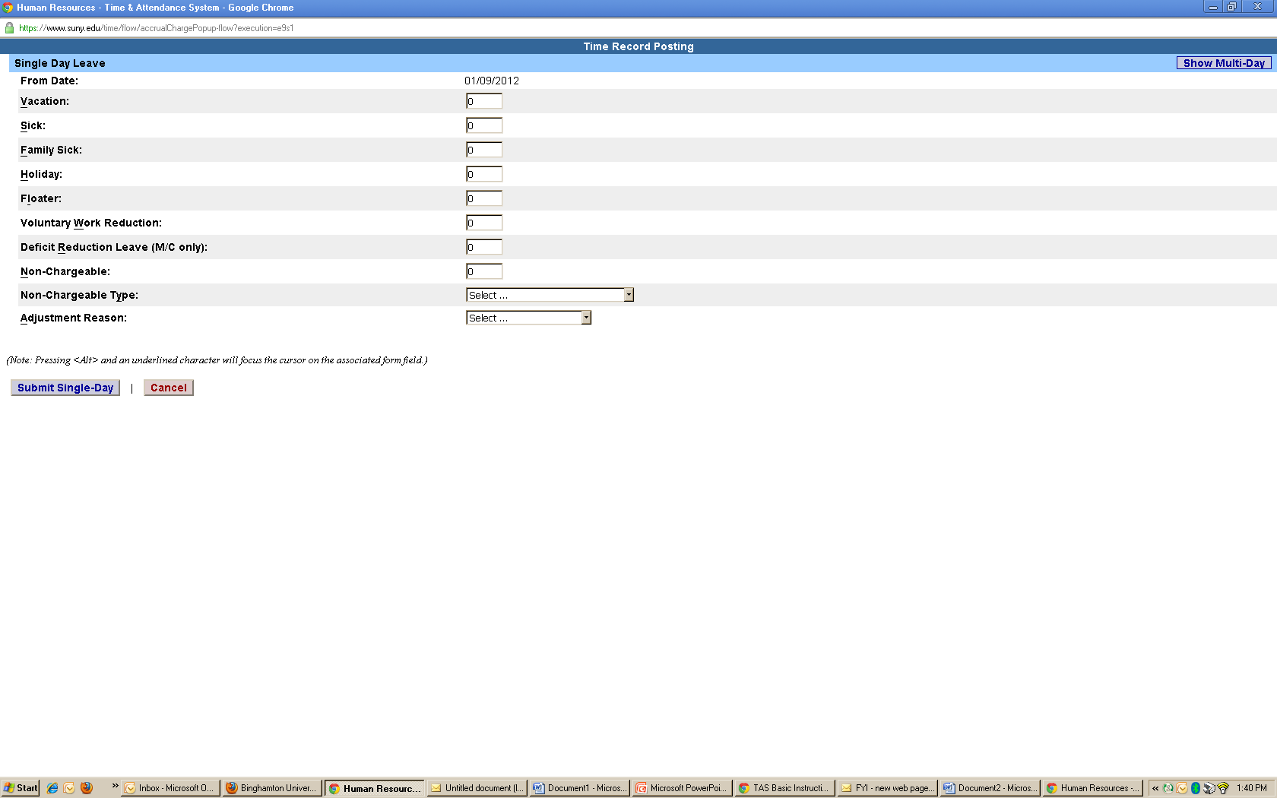
A) View of Sub-Menu Produced by Clicking on Individual Calendar Dates –
Single-Day Entries
SINGLE DAY
view
Click here to change to MULTI-DAY view
Remember to scroll down and click the save button

Slide 14
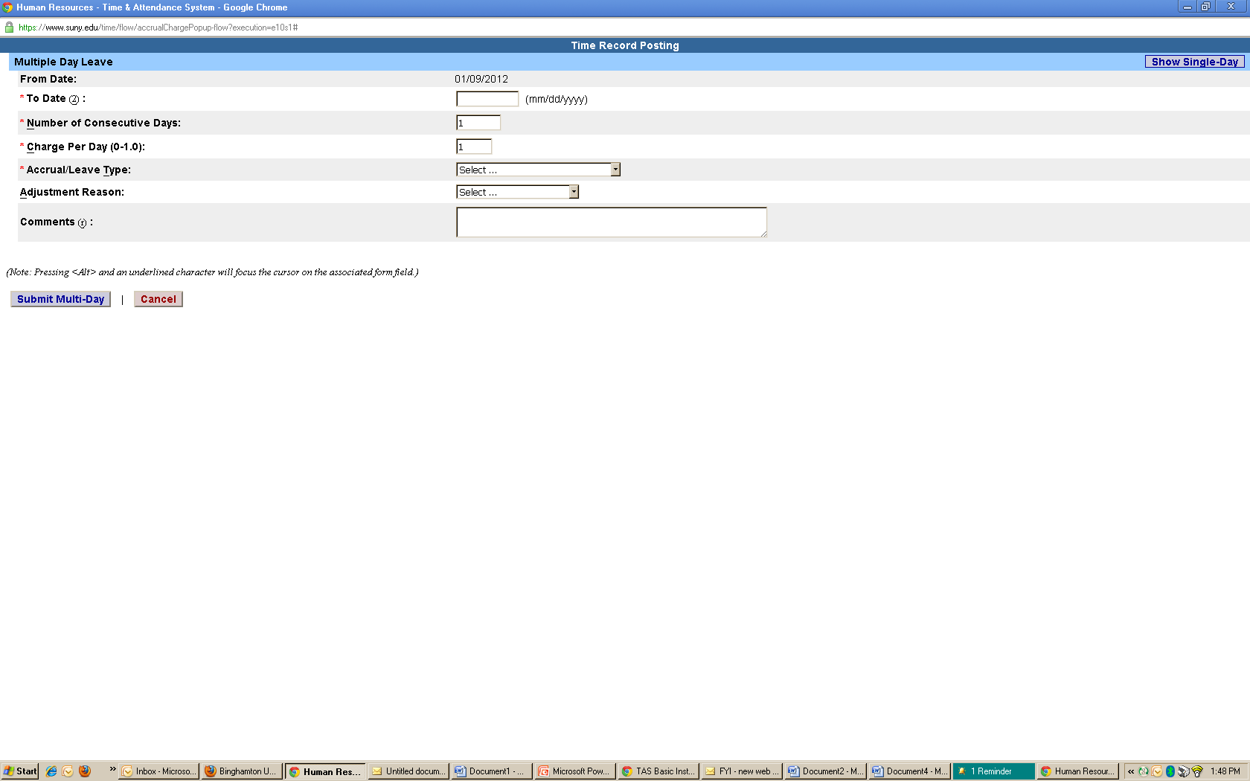
B) View of Sub-Menu Produced by Clicking on Individual Calendar Dates-Multiple Day Entries
MULTI-DAY
view
Click here to change to SINGLE DAY view
Remember to scroll down and click the save button

Slide 15
“TIME RECORD COMMENTS”
All Employees: Use this box to indicate any items you’d like noted on your record for your supervisor or for audit purposes.

Slide 16
LAST STEPS:
1) Review Entries for Accuracy,
2) Certify (Sign), and lastly,
3) Submit to Supervisor.
1) Review your entries for accuracy
2) Certify
b
3) Submit

Slide 17
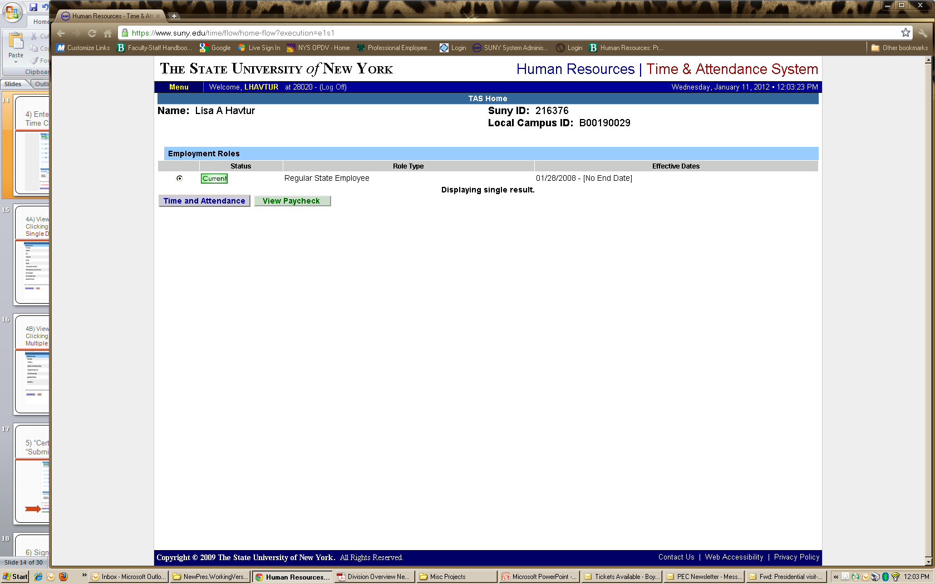
Sign out of the SUNY browser and close
To ensure your privacy and system security, in addition to “Logging Off,” you will also need to “X” out of the SUNY browser. (You can do this by clicking on the box in the upper right hand corner of your screen).
Step 2:
Close browser
Step1:
Log-Off

Slide 18
E-MAIL NOTIFICATIONS
Time record submission is a MONTHLY process.
System-generated e-mail reminders will be sent when your monthly time records are overdue. Notifications will also be sent if your time record is denied by your supervisor.
*Helpful Tip: Set a calendar reminder to complete your previous month attendance record on the first of every month

Slide 19
SUPERVISOR GUIDELINES Electronic Time and Attendance

Slide 20
SUPERVISORS RESPONSIBILITIES
View Work Roster
View time information of your Direct Reports using the “Work Roster”
Review and Approve
Select “Approve,” “Deny,” or “Postpone”
Submit
Submit, Log-off, and Close Browser

Slide 21
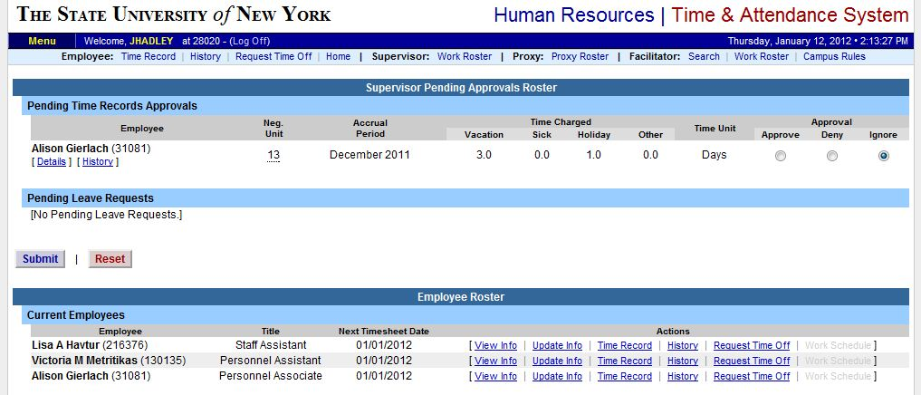
Supervisors will have a “Work Roster” showing the electronic timesheets for direct reports
Select
“Work Roster”

Slide 22
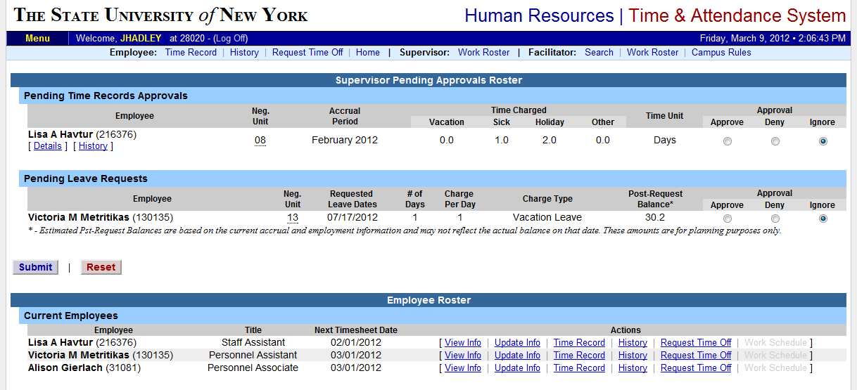
View of Employee Work Roster
Pending Time Record Approvals
Pending Leave Requests
Employee List

Slide 23
1) View Employee’s Time Record
2) Determine an Action
3) Then, “Submit”
View details or history of time record
2) Select action
3) Submit

Slide 24
Sign out of the SUNY browser and close
To ensure your privacy and system security, in addition to “Logging Off,” you will also need to “X” out of the SUNY browser. (You can do this by clicking on the box in the upper right hand corner of your screen).
Step 2:
Close browser
Step1:
Log-Off

Slide 25
Additional FEATURES AND information

Slide 26
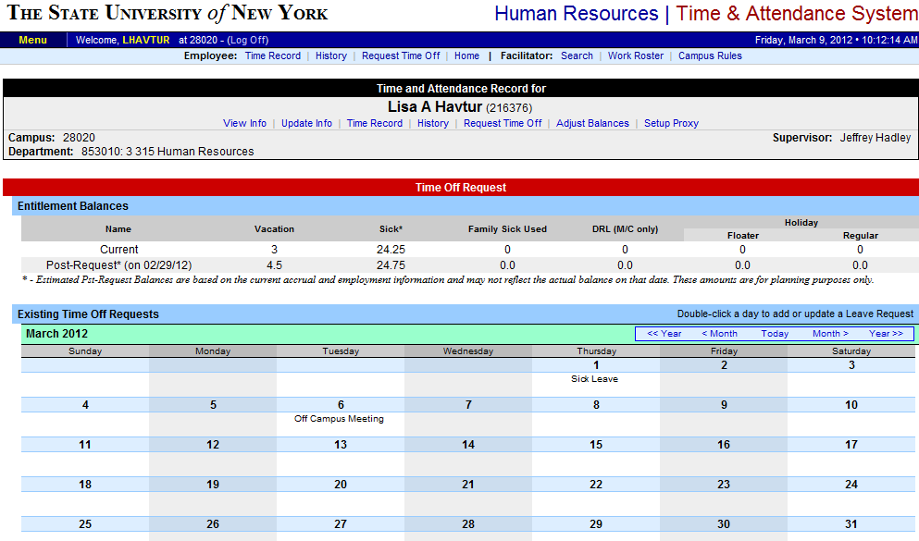
Electronically Requesting Time Off
Use of this feature is completely OPTIONAL between you and your supervisor.
Discuss with your supervisor how this may change your current procedures.
REQUEST TIME OFF
Selection
Click on TIME RECORD to return to the MAIN SCREEN

Slide 27
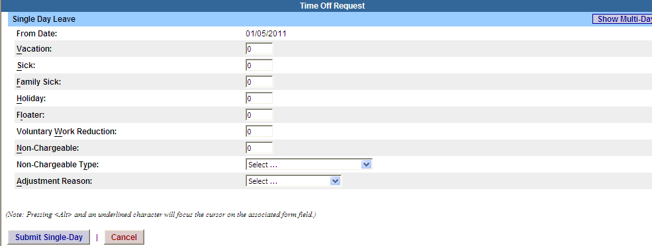
Time Off Request Form
Single Day Request
Click for Multiple Day requests
Enter charges in appropriate categories
Click Submit

Slide 28
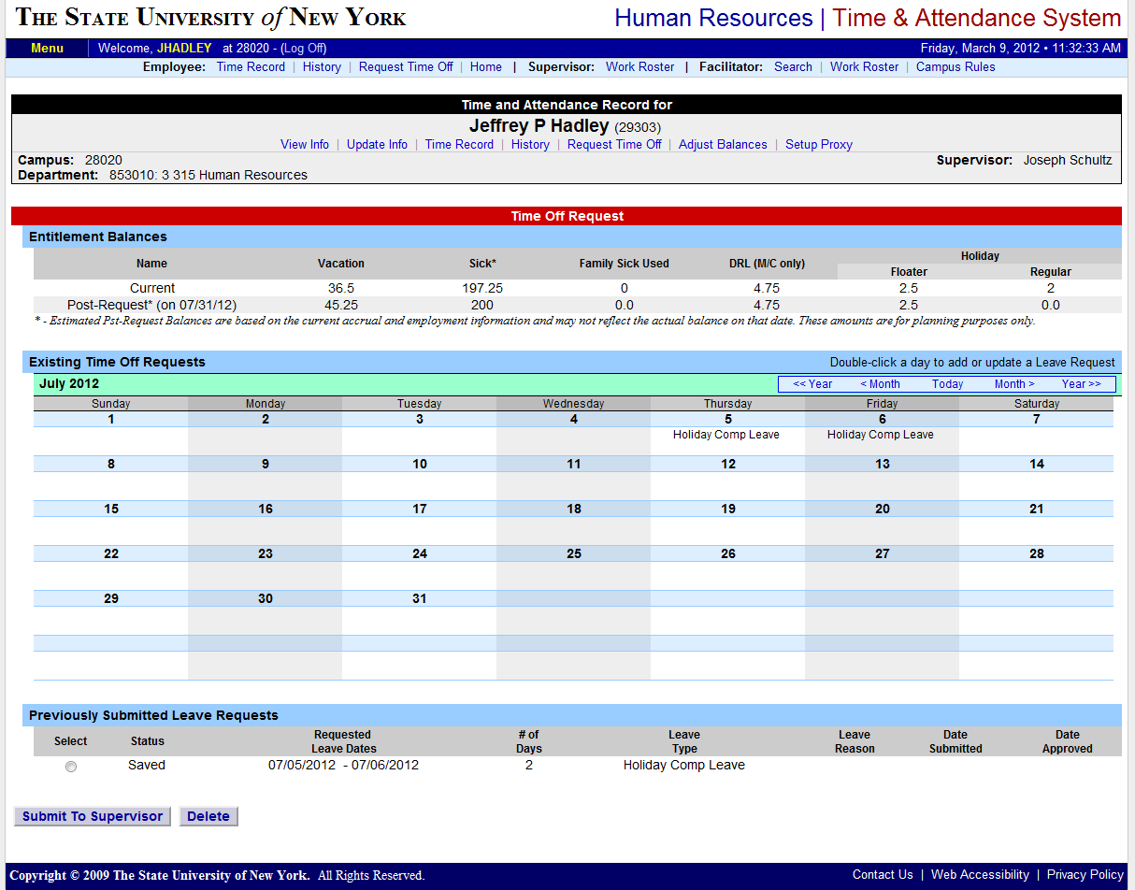
When Using This Feature,
Remember to “SUBMIT” Your Request
Once your supervisor has approved your request, it automatically populates on your record so you won’t have to enter it. (Will appear with a “P” while the request is pending)
Changes, additions, deletions can be made at any point; this is not a “contract.”
Be aware that unresolved requests can prevent your successful monthly-time record submittal.
Remember to “SUBMIT” your request

Slide 29
ABOUT LEAVE DONATIONS
FOR THOSE WILLING TO DONATE VACATION DAYS:
Your generous Leave Donations will continue to be administrated through the Human Resources and Payroll Office, following the current procedure.
Upon receipt of your Leave Donation Form, the Payroll Office will make the necessary electronic transactions.

Slide 30
Thank You!
Please contact Susan Cortes for further assistance.
Phone: 673-3775
E-mail: Susan.Cortes@fredonia.edu

