Slide 1
Fredonia Foundations

Slide 5
Website
www.fredonia.edu/fredoniafoundations

Slide 6
Course Search
Public Search
History Website
Course number and name changes
COMM 101:
Humanities FF: Only for students who took the course F18 or beyond
MUS 233: CCC Other World Civ, FF ARTS

Slide 7
Degree Works

Slide 8
Advising Sheet

Slide 9
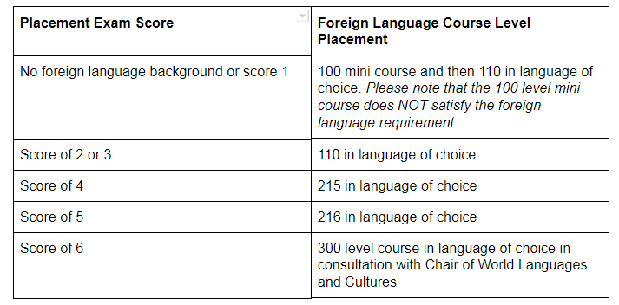
Foreign Language
20-40 minute placement exam
2-5 business days for results
Score is valid for 2 semesters ONLY

Slide 10
Foreign Language
First Placement Exam will be offered on Thursday, August 23rd
Fall 2018 offerings beginning in October
SPAN 100 (restricted, score 1 or no background)
FREN 100 (restricted, score 1 or no background)
ITAL 100 (no restrictions)
More to come:
GERM 100 (no restrictions)
RUSS 100 (no restrictions)
ARAB 100 (no restrictions)
AND ALL 110 course offerings

Slide 11
Foreign Language
Sign Language
Currently still in the CDS department
Student must complete CDS 215 (Intermediate Sign Language)
Exceptions
International students or any student who can demonstrate a native or near-native proficiency in a language other then English

Slide 12
Transfer Students
IF a transfer student has completed an AA or AS within the last 5 years, Fredonia Foundations has been fulfilled (assuming 7/10/30 is complete)
IF a transfer student needs to fulfill Fredonia Foundations course work, themes are ENCOURAGED but not required
1 course = any thematic area
2 courses = two different thematic areas
3 courses = three different thematic areas
4 courses = one from each plus one from any thematic area
5 courses = one from each plus one each from two different thematic areas
6 courses = two each from each thematic area
IF no degree BUT 7/10/30 is complete, the student has fulfilled Fredonia Foundations

Slide 14
Amy Leclair
Director Academic Advising
amy.leclair@Fredonia.edu
673-3188

