Slide 1

2025-2026 Financial Aid Overview
Presented by
SUNY Fredonia’s
Financial Aid Office
www.fredonia.edu

Slide 2

What Is Financial Aid?
Financial aid consists of funds provided to students and families to help pay for postsecondary educational expenses (i.e. loans, grants, scholarships)

Slide 3
Filing for Financial Aid!
Fall 2025 students file your 2025-26 FAFSA available December 1,2024
  Using 2023 Federal Tax information
  You can list up to 20 schools on the FAFSA
File your 2025-26 NYS Student Aid Payment Application for TAP grant
  Available at hesc.ny.gov
File your 2025-26 Excelsior Scholarship Application
  Application Date TBD (usually releases in spring)
  Sign up for email alerts at hesc.ny.gov

Slide 4
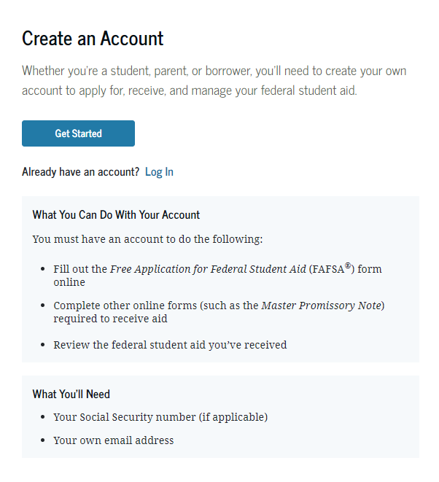
StudentAid.gov Account Username and Password (FSA ID)
Used for FAFSA completion
and access to certain U.S. Department of Education websites
Student and parent must
create own FSA ID
Save securely for future use
Create an Account now at https://studentaid.gov/fsa-id/create-account/launch

Slide 5
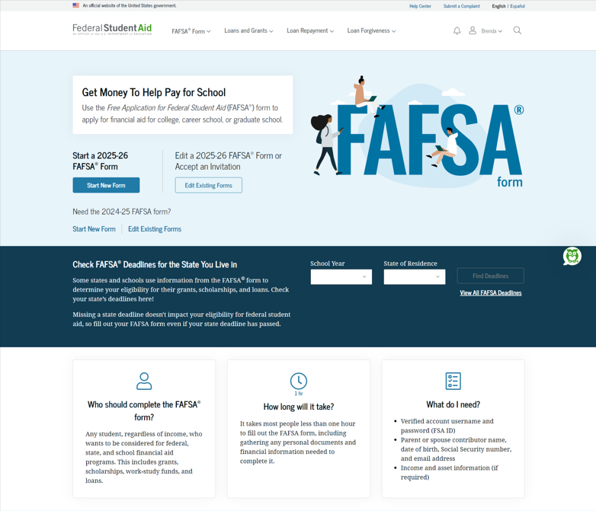
Free Application for Federal Student Aid (FAFSA®)
Collects demographic and financial information from 2 years prior in order to calculate the student aid index (SAI)
Colleges use SAI to determine your financial aid
The 2026-27 FAFSA can be filed starting October 1st

Slide 6
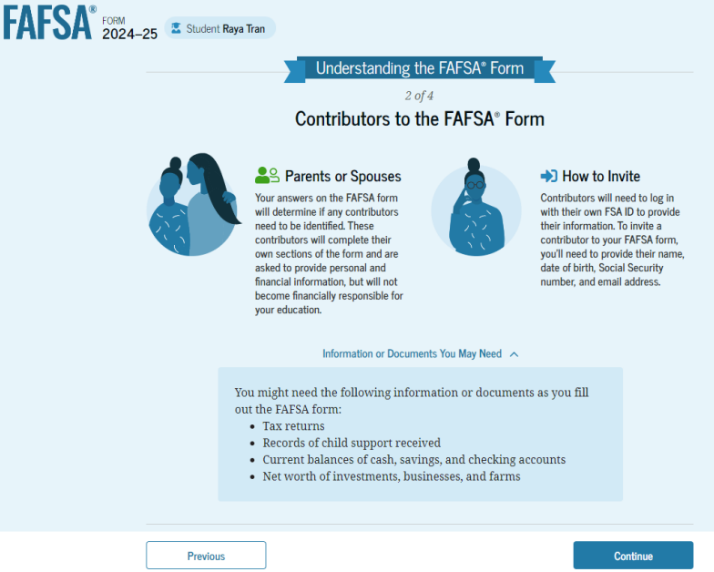
FAFSA Contributors

Slide 7
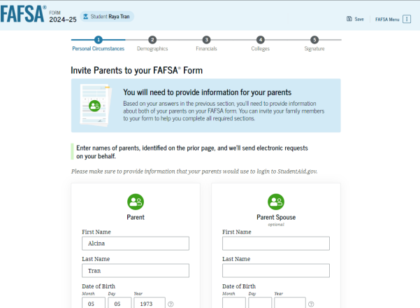
Student Invites Parents to FAFSA
Student provides personal information about parents to invite them to complete parent portion of the FAFSA

Slide 8
Which parent is my contributor?
If parents are:
Married and filed their Federal income tax return as Married Filing Jointly then only one parent contributor is required to complete the FAFSA.
Married and filed separately, both parents will be considered contributors and therefore need separate FSA IDs and both must provide consent
Unmarried and living together, both parents will be contributors, need separate FSA IDs, and need to provide consent.

Slide 9
FUTURE Act Direct Data Exchange (FA-DDX)
Allows for an individual’s federal tax information (FTI) to be directly transferred from the IRS to the FAFSA
Consent is required by all contributors on FAFSA
IRS transfers information to populate FAFSA income questions for most tax filers
Eliminates manual entry of tax and income information

Slide 10
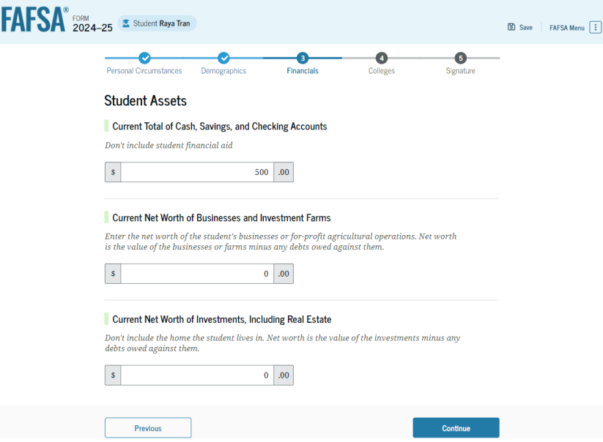
Student Financial Information
If the DDX is used you will only have to answer minimal income information questions (i.e. assets, wages)

Slide 11
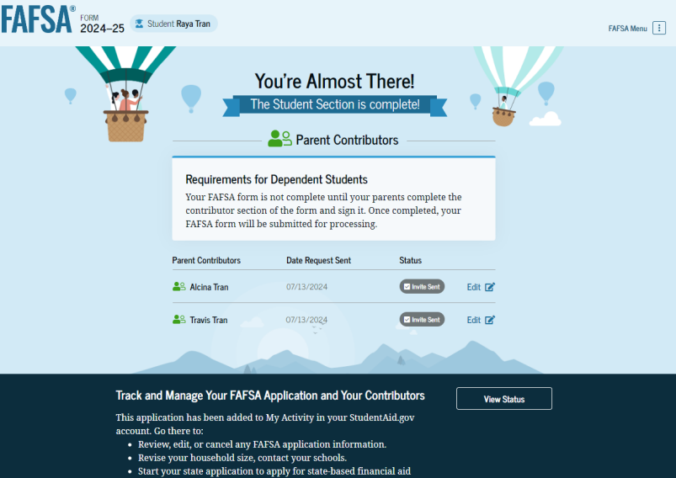
Student Section Completion
College selection
Review of information
Signature

Slide 12
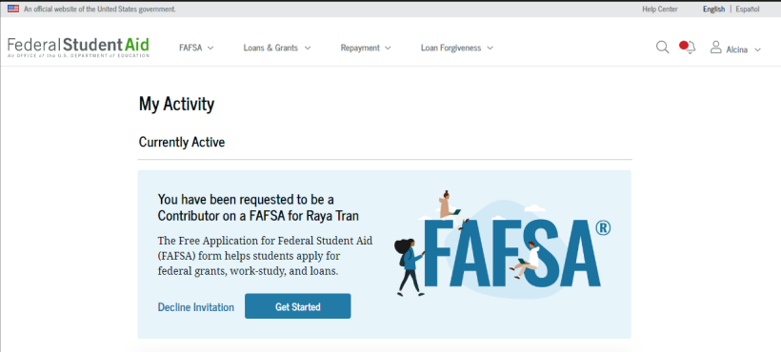
Parent Invitation
Find the email invitation previously sent by student during their FAFSA completion portion in order to complete parent portion of student’s FAFSA
Parents must use their FSA ID to access FAFSA

Slide 13
Parent Information Reported
Basic info (i.e name, SSN, address, State of legal residence )
Marital status
Federal tax return information
  If the DDX is used you will only have to answer minimal income information questions (i.e. assets, wages)

Slide 14
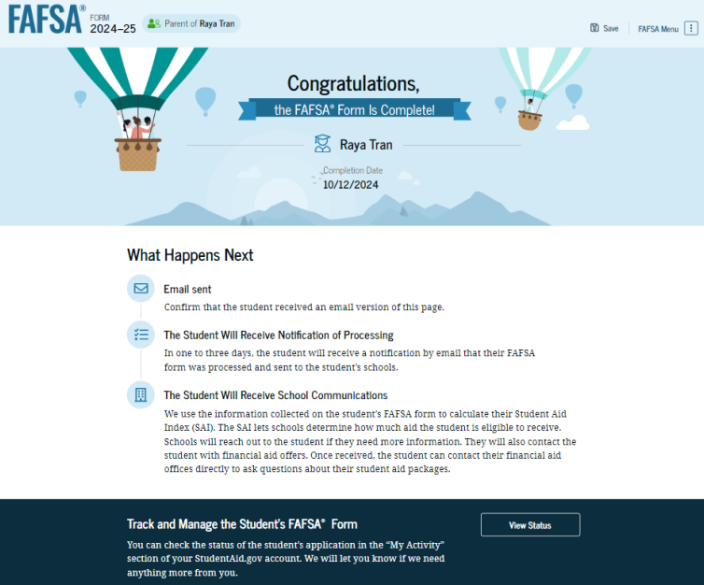
Parent Section Completion
Review of information
Signature and submission of FAFSA

Slide 15
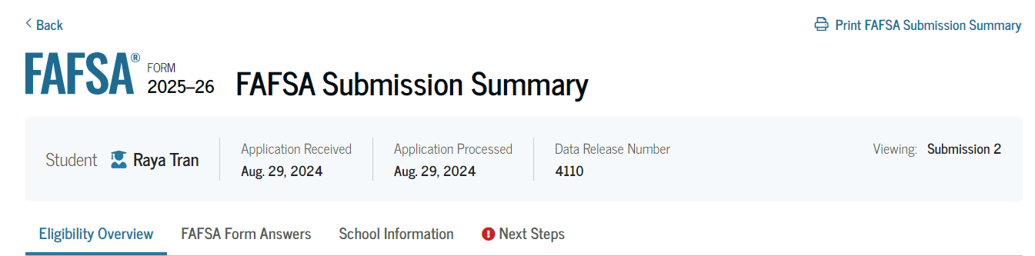
FAFSA Submission Summary
Four sections:
  Eligibility Overview
  FAFSA Form Answers
  School Information
  Next Steps
Ability to print summary

Slide 16

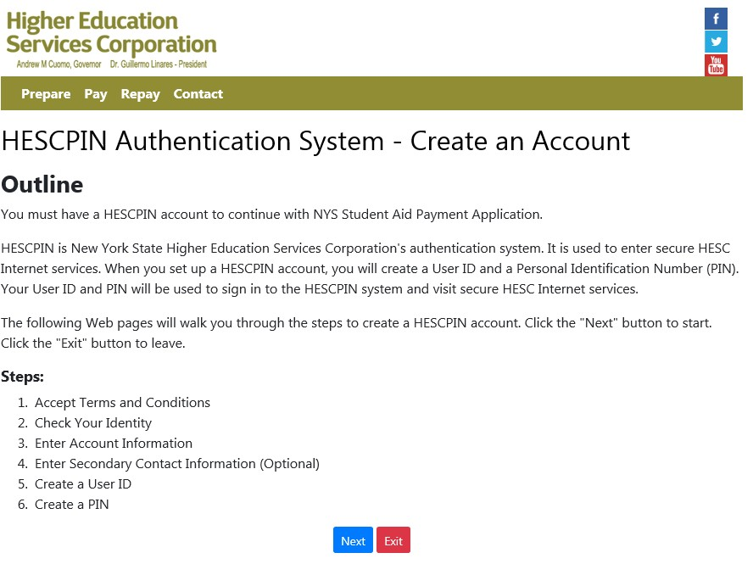

Creating a HESC Account (hesc.ny.gov)
NYS Tuition Assistance Program (TAP)
16

Slide 17

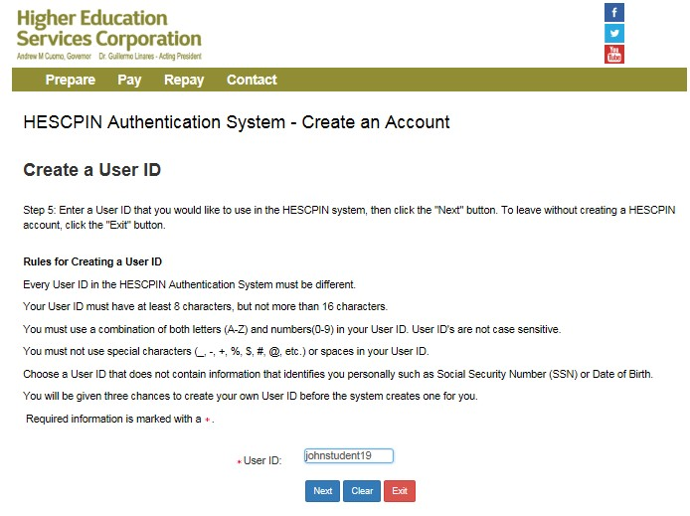
Create a User ID
22
TIP:
Be sure to select the correct year (2025-2026).

Slide 18

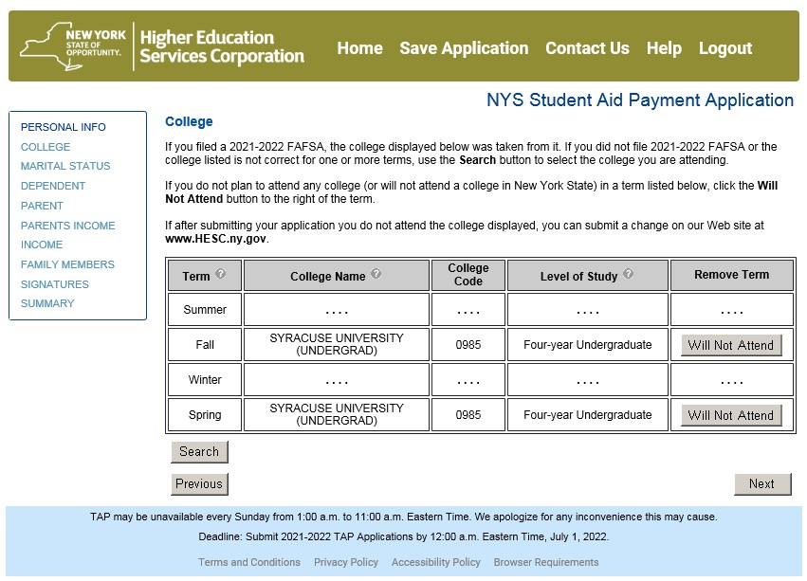
Review Prefilled College Info From FAFSA
34

Slide 19

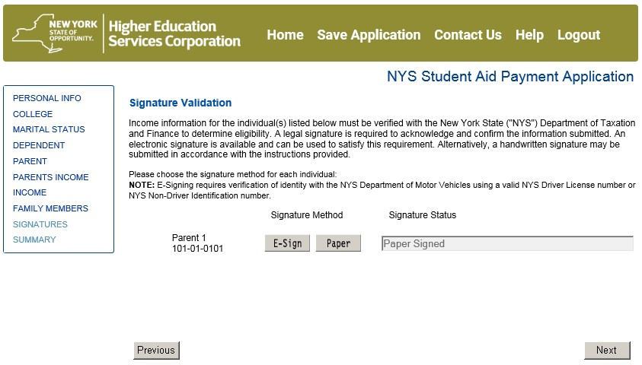
Signature Validation (Parent Signature)
54
Choose E- Sign or paper signature

Slide 20

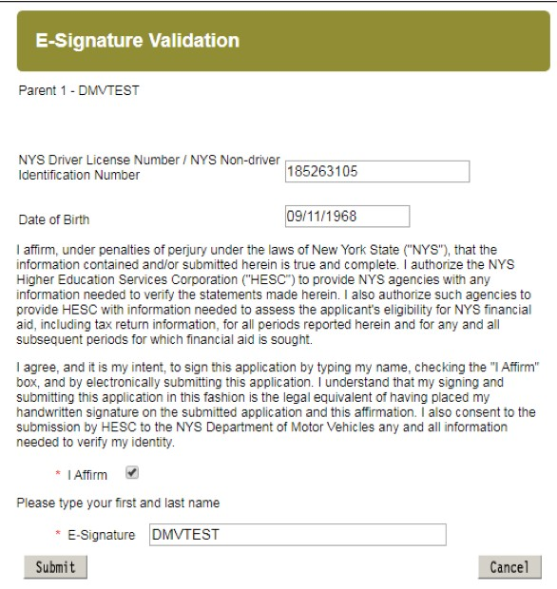

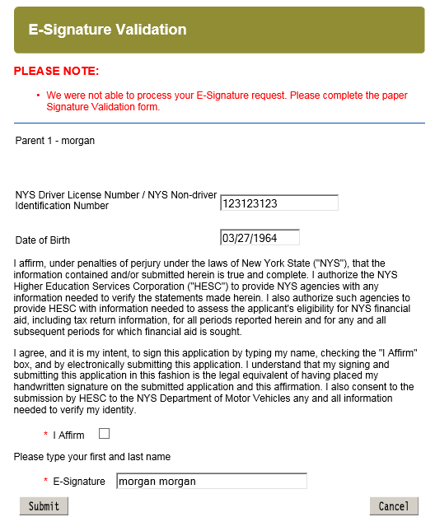
E-Signature: NYS DMV-issued ID
55
If e-signature does not work, then choose the paper signature option

Slide 21
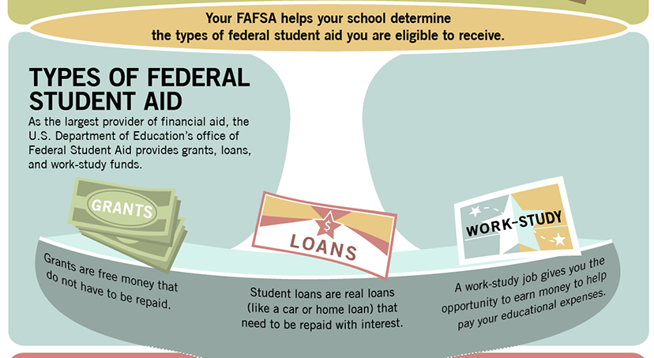
Sources of Financial Assistance

Slide 22
Grants
Federal Pell Grant (Federal)
  Pell eligibility is based on the student aid index (SAI) determined by FAFSA
  Current annual maximum grant is $7,395 in 2024-2025
Tuition Assistance Program (TAP) (State)
  Funding levels are determined each year by the NYS budget process
  Annual maximum is $5,665
  SUNY Tuition Credit for those who receive a TAP grant and are attending SUNY/CUNY

Slide 23
Federal Work Study Program
Need based work program
  Limited funds (typically first come first serve)
  Early FAFSA application is critical at most schools

Slide 24
The Excelsior Scholarship
Fall 2025 eligibility based on 2023 Federal AGI being less than $125K. Award is calculated against current tuition rate. For 2024-25 annual SUNY/CUNY tuition rate is $7,070.
How it works:
  Is a “last dollar” scholarship
  Annual award equals school’s tuition cost minus any amounts received for TAP, Pell or other scholarships
  Must file FAFSA, NYS Payment Application and then Excelsior application (One time application). Must submit FAFSA and TAP application annually.
  If HESC finds that student is eligible for Excelsior then student must sign Excelsior contract.
More information: hesc.ny.gov

Slide 25
The Excelsior Scholarship: Eligibility Requirements
Be a resident of New York State
Household federal adjusted gross income for 2023 cannot exceed $125,000.
Enroll in a SUNY or CUNY two or four year degree program
Earn 30 credits per calendar year (including winter and summer terms)
Live and work in New York following graduation for the length of time you participate in the scholarship program

Slide 26
Federal Direct Loans
Maximum loan amount between the two types for first-year is $5,500
2 Types
  Subsidized loan
    6.533% with an origination fee of 1.057% (2024-2025 rates)
    Need based loan
    Federal government pays interest while student is in school
    Can get up to $3,500 out of the $5,500 max in this type
  Unsubsidized loan
    6.533% with an origination fee of 1.057% (2024-2025 rates)
    Not based on financial need
    Student is responsible for interest while in school
    Loan cannot exceed cost of education minus financial need
**Loan rates are subject to change

Slide 27
Alternative Financing Options
  Parent Loans for Undergraduate Students (PLUS)
    For parent(s) of dependent students
    Borrow up to entire cost of college less financial aid
    Parent must pass credit check
    Fixed interest rate of 9.083% / Origination fee of 4.228% (2024-2025 rates)
  Payment Plans
    Varies across institutions. Families spread the direct costs over the semester or year.
  Private Loans
    Student loan with a co-signer
    Interest rate based on credit score and bank rate (Most lenders now offer both a fixed and a variable rate product)

Slide 28
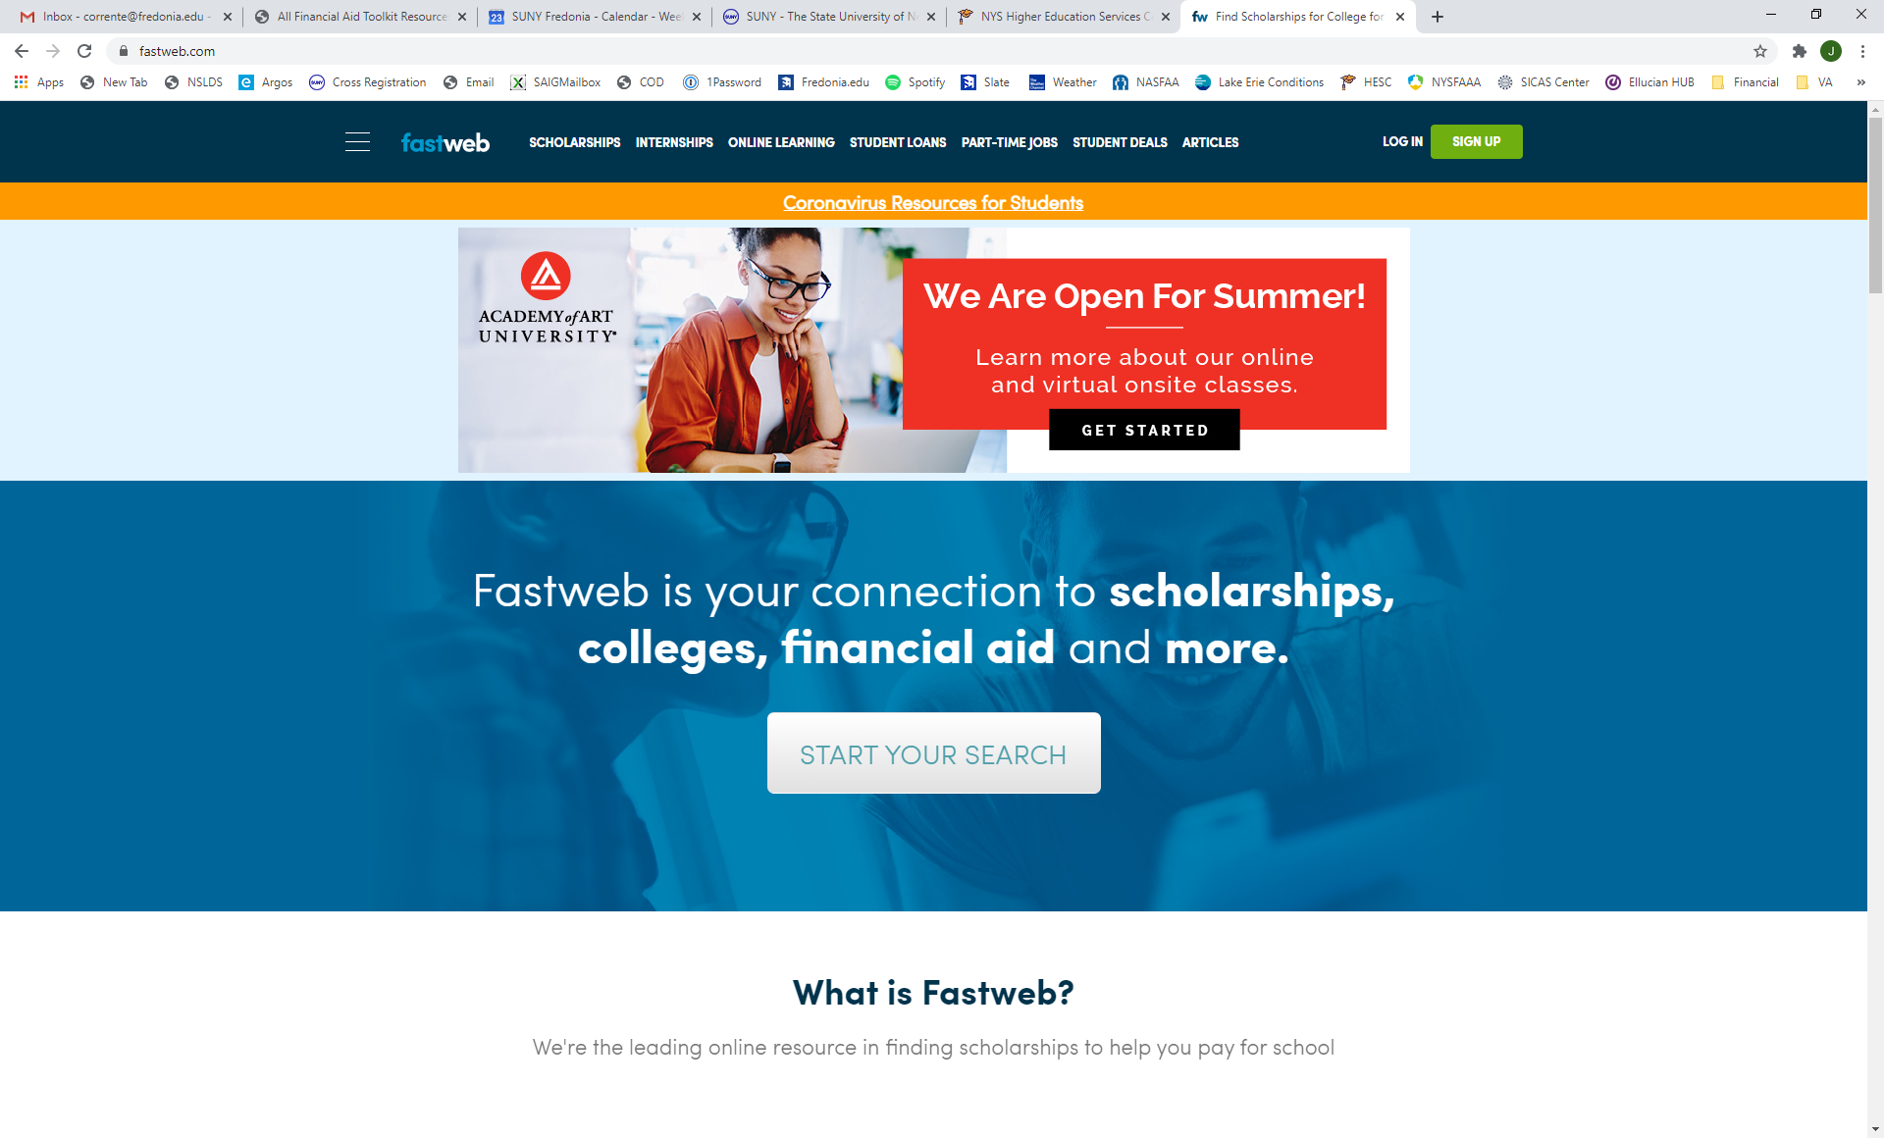
Apply for outside scholarships at fastweb.com

Slide 29

Special Circumstances
Unusual uncovered medical/dental expenses
Loss of employment or income
Parent or spouse death
Divorce

Slide 30
QUESTIONS?

